Slide 1
Creating Dollars to Fund the Green New Deal – Taxing Rentiers to Prevent Inflation
Ron Baiman
Benedictine University
Chicago Political Economy Group
Public Presentation
Henry George School
Chicago, IL
March 13, 2019

Slide 2
Contents
Capitalist Economics
Socialist Economics
Anti-Rentierist Economics
Funding a Green New Deal and Marshall Plan

Slide 3
Capitalist Economics

Slide 4
Book Plugs:
The Morality of Radical Economics: Ghost Curve Ideology and the Value Neutral Aspect of Neoclassical Economics, Palgrave, 2016
(Chapter 5)
Ricardo’s Mathematical Free Trade Error: There is No Alternative to Managed Global Trade, Routledge, 2017
(Chapter 8)

Slide 5
Alternatives to Introductory Economics Memes
Two foundational ideals of Neoclassical (NC) introductory economics are:
“Perfectly Competitive Free Market” (PCFM)
“Free Trade” (FT)
Two iconic memes that ostensibly support these are:
“Supply and Demand” (SDM)
“Ricardian Comparative Advantage” (RCA) memes
But both of these doctrines are fundamentally in error for both economic and logical reasons, and should be replaced by alternative memes:
“Demand and Cost” (DCM)
“Unequal Exchange” (UE)

Slide 6
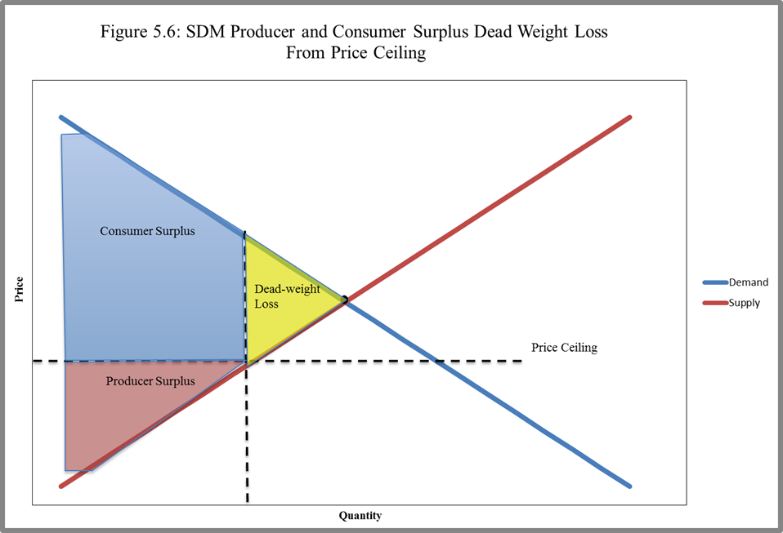

Slide 7
The Mostly Fake SDM Story (Baiman, 2016, Chap. 5)
In one relatively simple story with just enough analytical and graphical content to give it an aura of objectivity and science, the fundamental principles of our SDM social religion can be hammered home.
The SDM shows that given a stable DC and SC, or constant supply and demand shift-factors, competitive markets will “clear” at the unique equilibrium price and quantity where DC and SC intersect where “quantity supplied” equals “quantity demanded.”
This is a self-adjusting stable equilibrium that will be arrived at through individual consumer and producer reactions to “price signals.”

Slide 8
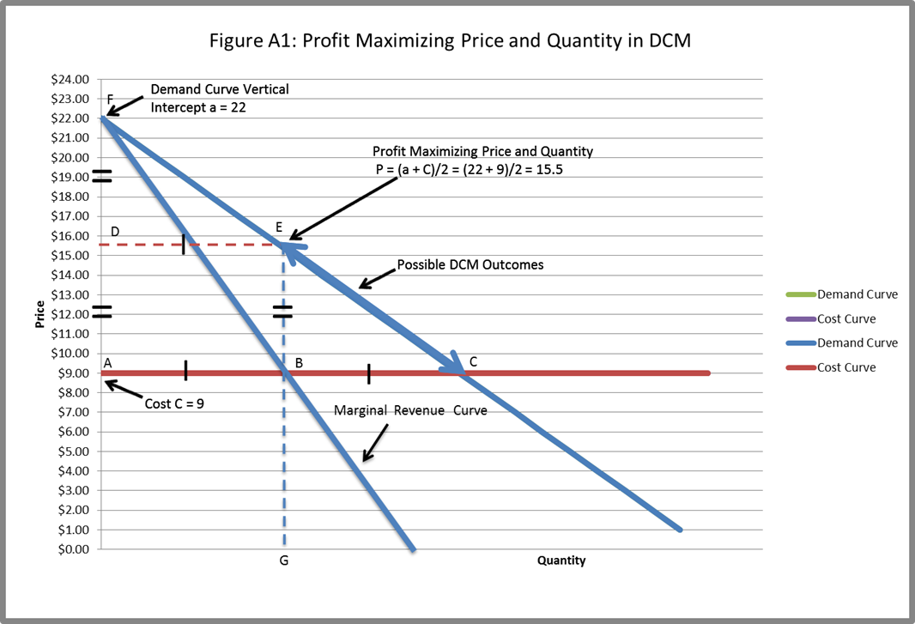

Slide 9
The Mostly Real “Demand and Cost Model” (DCM) Story
All firms also face average total cost curves which are generally flat or slightly downward sloping in their normal range of production (Lavoie, Chap. 2) (Lee, 1998).
In order for the firm to stay in business these cost curves must be below the demand curve in normal production ranges.
Firms will generally apply a “mark-up” over costs that will demand on how much they want to sell and on their long term strategy.
If they want to sacrifice short-term profits to increase market share over the long run they will keep prices relatively low. If they want to maximize short-term profit and don’t care about market share they will keep prices high.

Slide 11
International Trade and Unequal Exchange (UE)
(Baiman, 2017 Chap. 2-4) proves that:
RCA is in fact mathematically overdetermined and supports managed trade rather than free trade
Meade’s NC proof of the existence of Free Trade (FT) equilibrium does not apply to much of world trade
Any exchange-rate-based FT model of international trade will be unstable and thus economically infeasible
Rather than FT, the analysis thus assumes a UE view of international trade (Baiman, 2017, Chap. 5-6) and applies this to a DCM analysis of international trade

Slide 12
Applying DCM to International Trade (Baiman, 2017, Chap. 8)
The DCM framework can be used to analyze international trade from a UE perspective by focusing on
Markup
Location of cost curve
Size of mark-up depends on global policy to maintain appropriate levels of competition
Location of cost curve relates to applying Unequal Exchange (UE) analysis to international trade policy.

Slide 13
International Trade Principles 1
Prices in any society should reflect the true social costs of that society.
Societies with higher social costs have the right to impose tariffs on goods and services produced in lower-social costs societies up to a level that equalizes these costs to producers in both societies, and rebate these revenues to support broad-based increases of social costs in lower-standard societies.
For more see: (Baiman, 2017) and Progressive Trade Principles: Reframing the Trade Debate

Slide 14
International Trade Principles 2
When, for political reasons or in order to support economic development, a higher social-cost society subsidizes production in a lower social-cost society by not imposing tariffs at this level, the burden of
These subsidizes should be shared by all producers and workers in the higher social-cost society, and not just by directly affected domestic producers and workers.
Only tariffs on trade between societies with comparable social costs, or tariffs that exceed levels that can be justified based on b) above, should be considered “predatory” and not permitted.

Slide 15
Socialist Economics

Slide 16
Capitalism: Competition, Conflict, Crisis, by Anwar Shaikh (Oxford, 2016)
Relative prices in mature capitalist economies and sectors largely track relative labor input.
Real new investment follows real incremental profit rates net of taxes and interest.
Turbulent price, profit rate, and real exchange rate equalization characterizes capitalist domestic and international markets
Capitalism is still fundamentally a class system of labor exploitation that intensified in the 1984-1993 period.
Baiman (2018) concludes that classical system of labor exploitation breaks down even further after 2005 and claims this was due to increased unequal exchange and rentierism.
This conclusion is based on a comparison of Figure 1 below depicting Shaikh’s Classical macro model based on 1949-2011 data to the Figure 2 extension of Figure 1 to 1949-2016, and on Slides 19-22. Profit share in Figures 1-2 is BEA share of non-labor income in total income. Unemployment intensity is official unemployment rate times duration of unemployment from BLS.

Slide 17
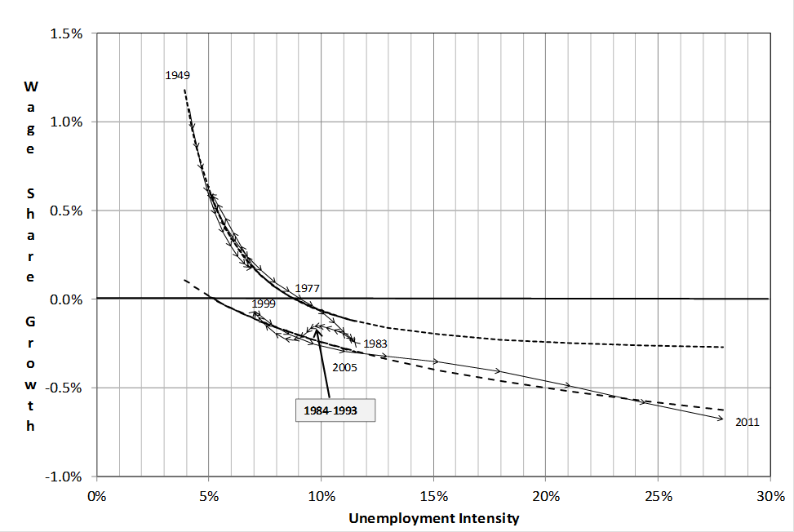
Figure 1: The Classical Phillips Curve: Wage Share Growth and Unemployment Intensity 1949-2011 (Shaikh Figure 14.14)

Slide 18
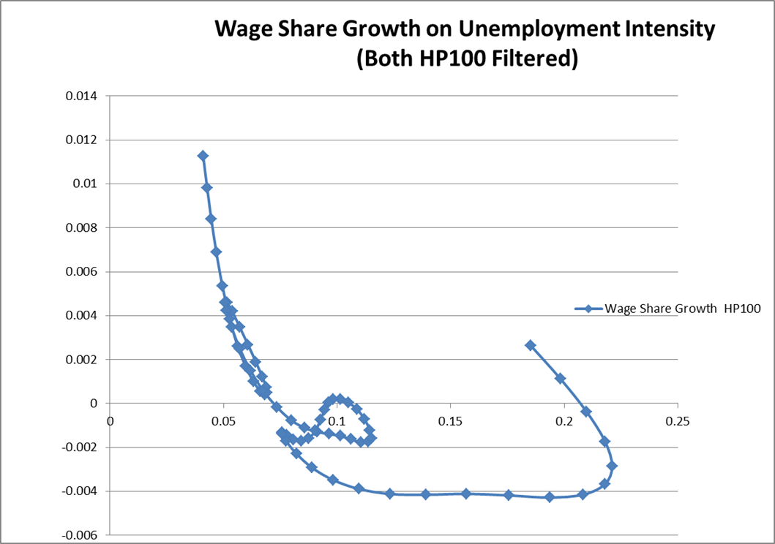
Figure 2: Updated 1949 – 2016 Classical Phillips Curve (Baiman, 2018)

Slide 19
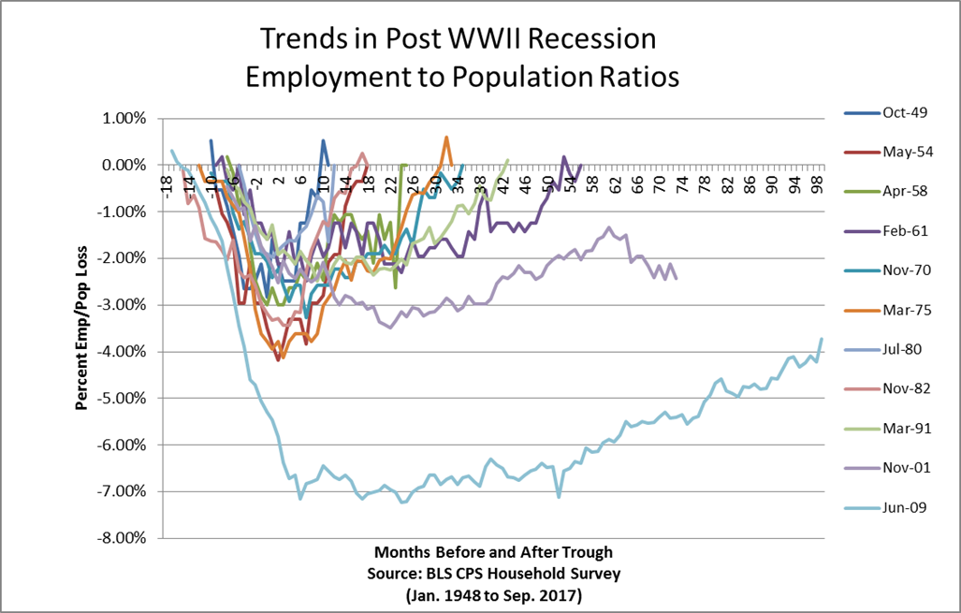
Figure 3: Percentage Change in Employment to Population Ratio from Immediate Pre-Recession Level for Post-War Recessions

Slide 20
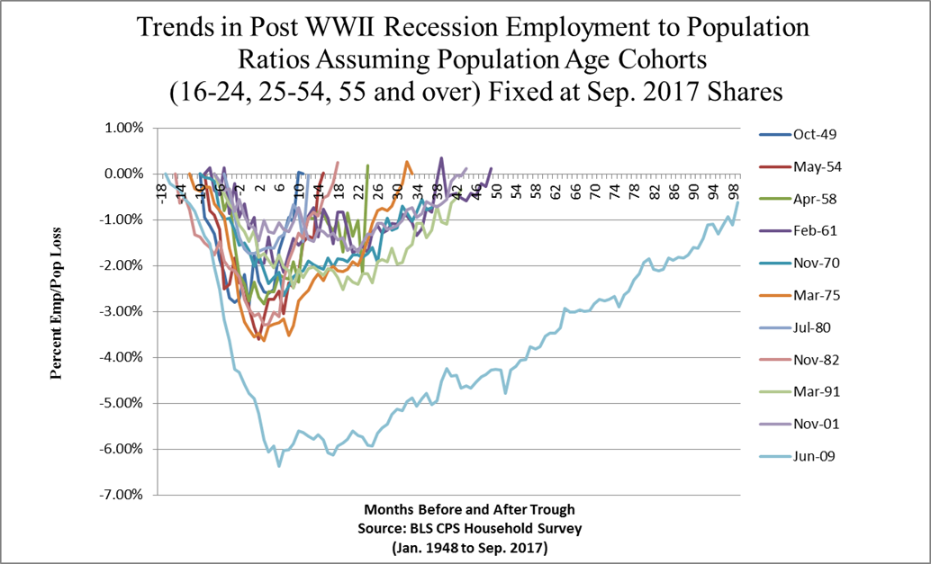
Figure 4: Demographically Controlled Percentage Change in Employment to Population Ratio from Immediate Pre-Recession Level for Post-War Recessions

Slide 21
Income Inequality is Proportional to the Share of Property Income
Econo-Physics Two Class (EPTC) theory of income distribution shows that labor income distribution (bottom 97%-99%) is approximately log-linear (Exponential) whereas property income (top 1%-3%) is approximately log-log (Pareto), or super unequal (Shaikh, p. 751-755).
Shaikh and Ragab (2016, Chap. 17) use this to show that the overall Gini Coefficient measure of inequality is correlated with property income share(eq. 17.6, p. 755):
Gini Coefficient = 0.5(1+ prop income/total income)
This demonstrates that recent extreme increases in inequality are driven by rentier (property) income, only a portion of which is standard capitalist profits on production (my conclusion not Shaikh’s – see Hudson discussion below).

Slide 22
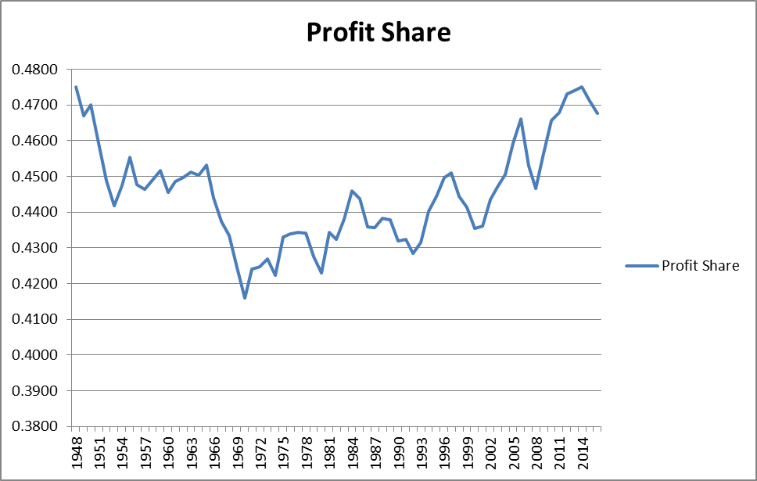
Figure 5: Profit Share 1948-2016

Slide 23
Anti-Rentierist Economics

Slide 24
The Bubble and Beyond by Michael Hudson (ISLET-Verlag, 2012)
Marxists believe that “profit” comes out of the production of the unpaid for “surplus value” production of labor.
Hudson and the “Neo-Rentierists” believe that in modern capitalism a large share of unearned income from property is “rent” from financial and real estate asset price inflation, and monopoly pricing.
These are transfers unrelated to, or above and beyond, surplus value in production.

Slide 25
In Standard Neoclassical (NC) National Income and Product Accounts (NIPA)
All economic activity is “productive”
Output = Income
Incomes from “labor, land, and capital” are all equivalent.
Hudson’s Neo-Rentierist income and spending flow depicted below is more consistent with the Marxist notion of profit from unearned “surplus value” in capitalist production.
However it includes Unequal Exchange (UE), “profit from alienation”, or “rent” in addition to standard capitalist profit from labor exploitation.

Slide 26
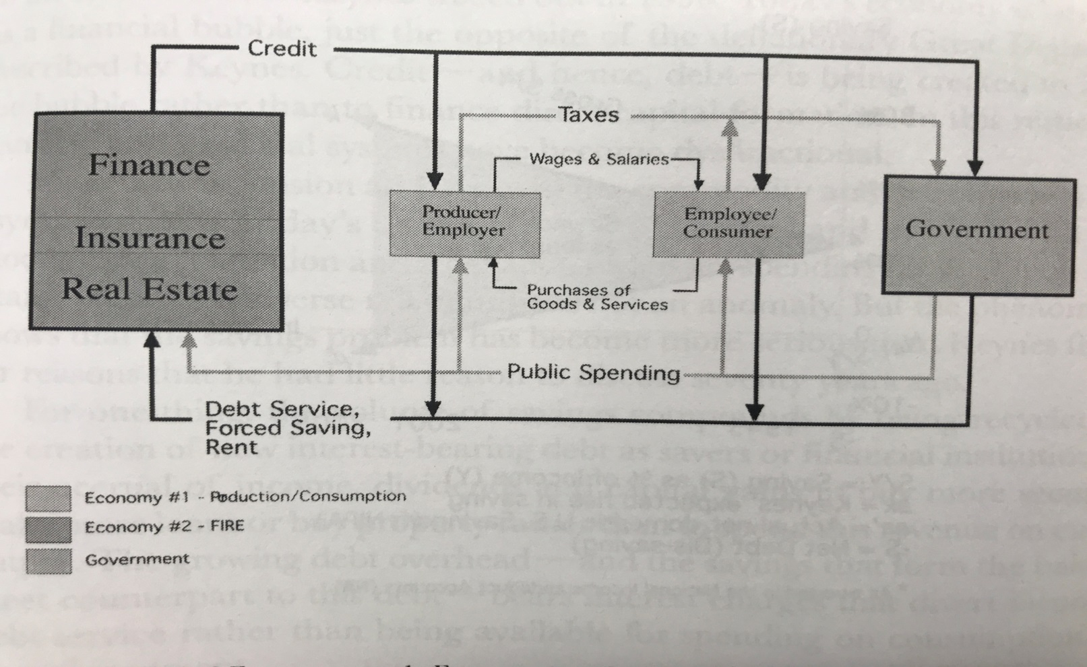
Hudson’s Neo-Rentierist Income and Spending Flows
Source: The Bubble and Beyond by Michael Hudson ( 2012, Dreden: ISLET),
Figure 3: “Interaction of Economy no. 1 , Economy no. 2 & Government”, p. 299

Slide 27
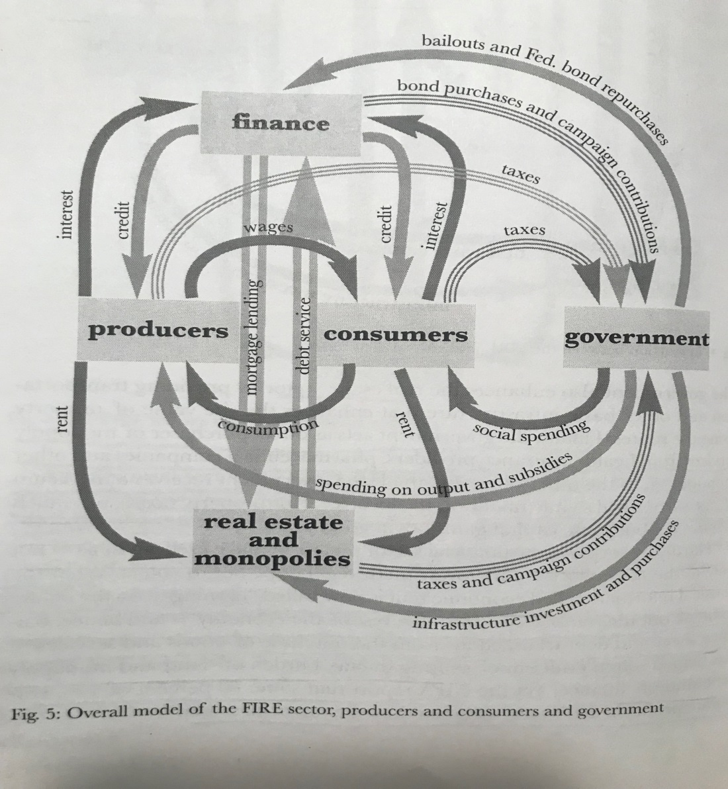
Detailed Hudson Neo-Rentierist Model (The Bubble and Beyond by Michael Hudson, Figure 5, p. 400)

Slide 28
“Rent” is Property-Based Income not from Surplus Value of Labor
The dominant source of rent is from “Finance, Insurance, and Real Estate” (FIRE) extraction of interest, rent, and other payments from debt that drives up asset prices.
Another source of rent monopoly pricing by dominant platform technologies, pharmaceuticals, health insurance monopolies, with the market power to raise mark-ups above normal profit levels.

Slide 29
Asset Price Inflation Causes Real Economic Deflation
Financial institutions raise real estate and financial asset prices by extending credit
Increased debt raises asset prices. Increased prices mean more “rent”, or higher mortgage and interest payments, for finance and increased collateral for more lending.
The counterpart to this debt is savings for FIRE and the wealthy that earns a geometric return that grows much faster than the real economy.

Slide 30
Income from Property and not Production is Rent
This is how financial institutions can extract payments from the economy without increasing real production or profit.
If this debt is not expunged in economic downturns (or through mandated “jubilees” as in classical antiquity) it becomes an ever greater burden on the real economy that if unchecked leads to social and economic collapse.

Slide 31
Hudson Analysis Tracks What is Happening in the Economy
M2 money supply has expanded by roughly $7.1 T from $ 7.4 T to $14.5 T from 2008-2019.
Roughly $3.4 T ($1.6 T Treasuries and $1.8 T Fannie, Freddie, and Ginnie securities) or 48% of this $ 7.1 T expansion has been directly created by the Fed via the financial bailout and Quantitative Easing (QE).
This has caused real estate (up 22%)¹ and financial asset prices (x2.5)² to rise along with non-financial private debt (up 46%)³.
But real economic growth for this expansion has been slower than prior periods of positive annual GDP growth: 2010 - 2018 average annual 2.3%, 1992-2007 3.3%, 1983-1990 4.1%, and inflation, or prices for produced goods and services (as opposed to existing assets), has been very low: with annual CPI average increases of 1.5%, versus 2.5% and 3.9%, for these same periods.
Notes: 1) Real residential property prices in US (FRED), 2) Dow Jones, 3) BIS credit to private non-financial sector from all sectors at market value long series 2009-2018.

Slide 32
Fed has Engaged in Massive Monetization that Benefits FIRE
When the Fed buys Treasuries all interest payments on these (minus a negligible amount for Fed overhead) are returned to the Treasury.
There is thus no reason for the Treasury to repay this “debt” to the Fed.
Similarly when the Fed has been buying mortgaged backed securities from Fannie, Freddie, and Ginnie (FF&G) it has been reinvesting interest and principal from these into more securities, thus returning the money to these agencies that are now publicly owned. This money is thus being recycled into the economy.
More recently the Fed has maintained a level stock of FF&G securities and tried (unsuccessfully) to significantly reduce its stock of Treasuries.

Slide 33
Fed Purchases of Treasuries 2008-2019 Explosion

Slide 34
Fed Purchases of Fannie, Freddie, and Ginnie Securities

Slide 35
M2 Money Supply Growth

Slide 36
Funding a Green New Deal and Marshall Plan

Slide 37
Financial Bailout Spending Would Have Almost Paid for Thirty Years of Global Climate Crisis Mitigation
Money created by the Fed for the three Year 2008-2011 financial bailout would have paid for almost thirty years 2020-2050 of global climate crisis mitigation.
Modern Monetary Theory thinking is useful for differentiating the easy to solve financial spending problem from the more difficult problems of economic resource reallocation and social equity,
The amount of spending, taxing and rationing, necessary for each of these goals will likely be different.

Slide 38
Why Should Federal Government Have to Tax or Borrow its own Money?
The moment a government takes over the task of creating money (as the Bank of England first did in 1694) the government is already "borrowing" from everyone who holds the currency. \
The government redeems its "borrowing" by accepting its own currency as payment for taxes - at which point these IOUs from the Government to holders of the currency are expunged.
Trust in the value of the currency (in the mostly "secondary" market where it's used) represents trust that others will value it.
For a long time this trust was based on, at least the perception of, a promise by the Central Bank, or Fed, that these IOUs from the government could be redeemed for gold (that everyone trusted for historical reasons), but since the era of fiat money, trust in the currency is based on trust that everyone else will trust it, and that the government will accept it as "Legal Tender" for paying taxes.

Slide 39
Monetization Constraints Have Been Lifted Numerous Times
In practice when the government spends, the Fed debits the Treasury’s reserve account and credits the reserve accounts of the banks where the spending ends up (or elsewhere if spent outside the Fed system).
As Kelton (formerly Bell) describes in great detail in her now classic paper "Do Taxes and Bonds Finance Government Spending" (JEI, 34 (4) Sep. 2000), there is almost always a mismatch between what's in the Treasury Reserve account and what the government is spending that is smoothed through various institutional means by the Fed to maintain a stable Federal Funds rate target.
The key point though is that if there are insufficient funds in the Treasury’s reserve account from taxes or bond sales, the only obstacles to the Treasury selling Bonds directly to the Fed to raise the necessary funds are self-imposed institutional constraints that can and have been lifted numerous times.

Slide 40
Fed Has Created $Trillions for Bailout and QE
Direct purchase is currently not authorized but in principle there is no reason why this constraint could not be lifted again, especially after the Fed has recently created trillions of dollars ex-nihilo on QE “open market” purchases of Treasuries, and Freddie, Fannie, and Ginnie mortgage backed securities.
Note for non-economists: Technically when the Federal Reserve buys Treasury Bills directly from the Treasury, the Treasury is “borrowing” money from the Fed. However, since all of the interest on T-Bills held by the Fed, minus a negligible amount for Fed overhead, goes back to the Treasury, this “debt” to the Fed never has to be paid back. It is therefore not really “debt” but simply money creation for the Treasury by the Fed, or direct “monetization” of government spending.

Slide 41
Spending, Slack, and Austerity are Separate Goals
We should thus focus on the really important issues of real economic resource use instead of the irrelevant “how do we pay it?” question.
Thinking about the problem this way directs planning toward how to create enough real slack in the economy to accommodate the enormous amount of new government spending on investment and employment that such a program would require.
As in WWII, such an expansion of real economic resource use will require offsetting reductions in consumer and other investment spending and production and probably direct rationing and price controls (as in WWII) to prevent unforeseen bottlenecks from leading to inflation instead of real resource reallocation.

Slide 42
Austerity Needs to be Focused on Rentier Sectors and Rich Households
The objective for taxing rentiers would be to reduce the parasitic burden that they place on especially lower income and wealth households and real production
Objective should be to eliminate or reduce the sacrifices in access to goods and services that productive sectors and poor households may have to make in a GNDMP transition.
Broad improvements in distributional equity and production efficiency will for obvious reasons make a GNDMP transition less painful, more feasible, and more equitable.

Slide 43
Kevin Anderson* on 10/9/2019 Democracy Now
About half of global emissions arise from the activities of just about 10 percent of the world’s population
About 70 percent of all global emissions of carbon dioxide come from about 20 percent of the world’s population.
And very closely, the emissions relate to the wealth or the income of the citizens
* Professor at the UK's premier climate modeling institution, the Tyndall Centre, and the University of Manchester.

Slide 44
Fed Monetary Commitments for Financial Bailout Totaled $29T
The most comprehensive estimate of the total amount of monetary “commitments”, including revolving cumulative lending, guarantees, and spending made by the Fed over 2008-2011 to bail-out global finance is $ 29 T.
Note that this is cumulative Fed monetary commitments over this time period that does not include money paid back, or guarantees that were no longer necessary.

Slide 45
Cumulative GHG Reduction, Costs, and Savings from Tech and Ag Changes for which Estimates Exist
Figure 6 below includes calculations based on estimates produced by “Project Drawdown” for 56 of the 80 methods for planetary GHG emissions drawdown for which global financial cost, and (for 53 of these) financial net savings, estimates have been produced.
The last row of the last three columns of Figure 6 show cumulative: CO2 eq reduction 555.46 GT (Giga Ton or billions of tons), Total Cost $28,881.56 (Billions US), and Total Net Savings $68,137.12 (Billions US).
The methods by which these costs and net savings estimates have been calculated could presumably serve as a basis for a “Green New Deal and Marshall Plan” (GNDMP) spending plan for 2020-2050.

Slide 46
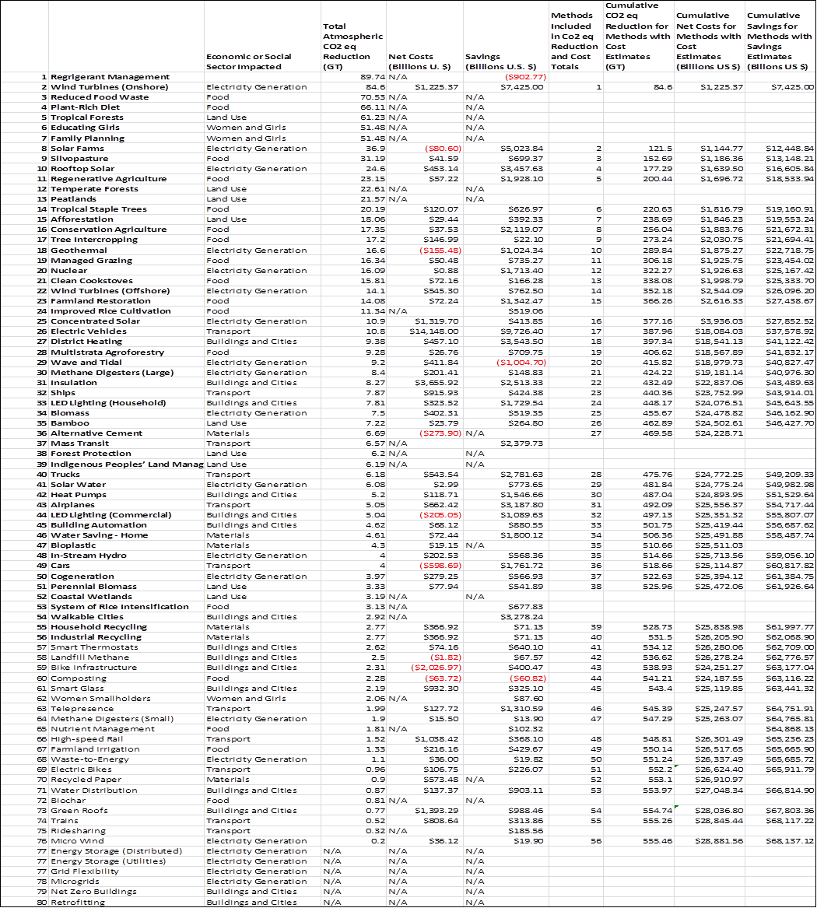
Figure 6: Cumulative Green House Gas Reduction and Cost and Net Savings Estimates 2020-2050

Slide 47
750 GT CO2 eq. 2020-2050 Reduction Will Keep Planet Below Climate Crisis Threshold
Figure 7 below from the 2017 United National Environment Programme report suggests that a roughly 750 GT of CO2 eq GHG atmospheric emissions reduction is necessary to get below the critical 2 degree Celsius global warming threshold over 2020-2050.
This estimate is based on using Figure 7 to approximate emissions at 55 CO2 eq. GT in 2020 and 20 CO2 eq. GT in 2050 on the red “Below 2 degrees C” curve, 70 CO2 eq. GT in 2050 on the “Business as Usual” yellow curve, and based on these estimates calculating the area of the triangle with base (70-20=50) and height (2050-2020=30) to get a total of 50x30/2= 750 CO2 eq. GT reduction needed to be “Below 2 degrees C” from 2020 to 2050.

Slide 48
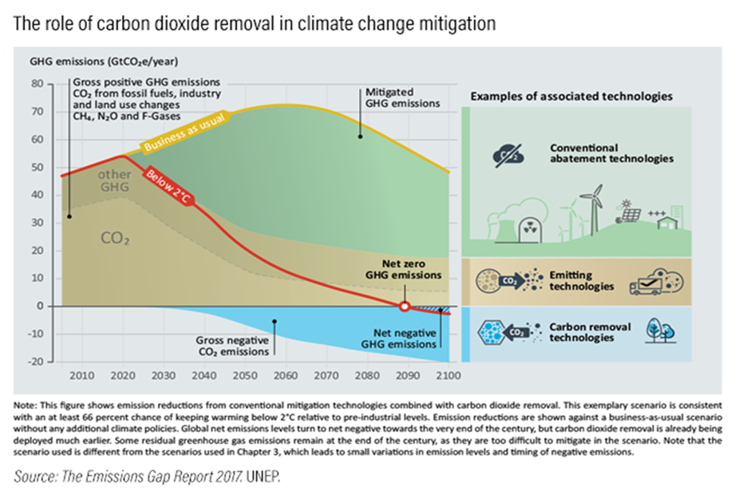
Figure 7: Green House Gas Emissions and Average Global Temperatures

Slide 49
Three Year 2008-2011 Financial Bailout Spending Would Have Paid for Almost Thirty Years 2020-2050 of Global Climate Crisis Mitigation
$29T Fed commitments for 2008-2011 bailout is roughly the same as the $ 28.9 T estimate above for the total amount of “cash” needed to pay to reduce GHG emissions by 555.46 CO2 eq. GT.
This reduction is 74.1% of the 750 CO2 eq. GT needed keep average global temperatures from rising by more than 2 degrees Celsius over the 2020-2050 period.
Note that this GNDMP spending estimate also results in a $68.1 T net savings estimate and a much longer 30 year “roll-over” period for the spending than the roughly 3 year 2008-2011 period for the $ 29 T global financial bail-out estimate.
There is abundant evidence that the Fed’s largesse was not just used to bail-out nominally U.S. (with global exposure) financial institutions, but also directly and indirectly through “counter-party” bailouts, “foreign” financial institutions (Hudson, Killing the Host (2015, Dresden: ISLET-Verlag).

Slide 50
Spending alone will not produce a Green New Deal and Marshall Plan
The increase (or decrease, if net financial savings resulted in job and income losses) in investment, employment, income, and consumption, particularly in developing countries, from GNDMP spending would need to be offset by taxing the wealthy (to create slack or more jobs) for global equity and so that this spending will result in reallocation and creation of real economic capacity to reduce net GHG emissions and not just bottlenecks and unsustainable inflation.
The 56 Project Drawdown projects summed up in Figure 1 not only exclude highly ranked methods for which cost and savings estimates are not available, but also family planning and other population growth reduction measures, and most importantly other critical GHG demand side reductions from income and wealth redistribution.

Slide 51
Neo-Rentierism or Species Survival?
For direct equity and efficiency reasons, and in order to most effectively reduce demand driven GHG emissions, U.S. demands for pay-backs should be tilted (like Marshall Plan Policies stipulating land reform and break-up of industrial monopolies) in a progressive direction toward taxing high income, wealth, and generally unproductive monopolistic rentier sectors like the “Finance, Insurance, and Real Estate” (FIRE) sector.
In this sense the GNDMP would be a complete reversal of the Neoliberal International Monetary, World Bank, and Federal Reserve policies of the last few decades.
The question before us may thus be framed in a nutshell. Are modern civilization and species survival more important than the Neoliberal order, and global finance and Neo-rentierism?

