Slide 1
Three Simple Reasons Why Illinois should Enact a LaSalle Street Tax Now!
Testimony to:
HB106 Subject Matter Hearing
Illinois House of Representatives 99th General Assembly
June 7, 2016
Chicago, Illinois
Dr. Ron Baiman
Benedictine University and
Chicago Political Economy Group
rbaiman@cpegonline.org

Slide 2
An LST would be Fair, Feasible, and Beneficial
1) Fair: The state needs far more revenue than is generally acknowledged.
All Illinois stakeholders, and especially the state’s wealthiest and most privileged industries (CME had a 37.5% profit margin and $1.25 B net income in 2015) need to contribute a fair share of public revenue. An LST is one of the largest, fairest, and most politically popular revenue raising options available to the state.
2) Feasible: The Chicago Exchange’s claim that they can easily move their operations out of state is demonstrably not true. The Exchanges and their customers are actually more, not less, place-bound than most industries due the phenomenon of “co-location” and “trading liquidity”. Illinois has the leverage to negotiate a fair and reasonable LST.
3) Beneficial: Relative to its over a billion dollars in net earnings, CME’s state income tax rate is already (unfairly) low, and in any case an LST would be a very modest sales tax on traders not on the Exchanges. Though an LST might reduce the most speculative kinds of high speed trading (HFT) and result in some loss of fees for the Exchanges, it would reduce rigged HFT trading and benefit non-speculative, economically useful, traders and overall trading integrity in the Chicago Exchanges.

Slide 3
FAIR

Slide 4
CME’s 2011 Tax Break
In 2011 Gov. Quinn and Illinois Democrats made the politically tough but responsible decision to raise corporate (and individual) income taxes.
CME, one of the most, if not the most, profitable corporations in Illinois with a 2011 net income of $1.812 B and a 55.2% profit margin (even as the state and its residents were still suffering from the horrendous affects of the 2008 economic collapse caused by irresponsible financial trading) complained that its state income taxes were too high and that if it didn’t get a tax break it would leave the state.
Illinois,, succumbed to CME’s threat and gave the company a tax cut that when fully implemented in 2014, was estimated to reduce its 2011 tax bill of $ 158 M, by $ 85 M, or 54%.
The justification used for this massive tax break, was that only 27.54% of CME’s electronic trades were executed, and thus taxable, in Illinois, under the state’s “single sales factor” corporate income tax law.
Even as CTBA Budget Director I was unable to find any data to back up this 27.54% figure, which I suspect was simply provided by CME. As estimates of HFT trading are typically around 50% (see NYTimes 7/72014), and these traders use on-site servers based in Illinois that meet the “single sales tax criteria” of within state service provision, it appears that CME effectively bluffed its way to a roughly 22% tax break.

Slide 5
LST Fee is Very Low Compared to State Sales Tax and Other Financial Transactions Taxes
The LST is not a Gross Receipts tax as it is not a business tax on gross revenue received from a produced good or service.
It is rather a consumer tax like the 6.25% Illinois state sales tax.
6.25% of the quadrillion dollars in notional value traded on the CME (based on CME CEO Terrence Duffy 5/26/2016 presentation at Springfield hearing) would be $65 Trillion.
Mr. Duffy testified that somewhere around 0.5% of CME volume “goes to delivery” and that he would accept an LST on these contracts. As 0.5% of a quadrillion is $ 5 trillion, a 6.25% state sales tax on this would be $ 325 billion.
The $12 billion in revenue raised by HB106 is equal to a 0.024% LST on CME volume “brought to delivery” (assuming revenue proportionality).
The LST fee is much lower than financial transactions taxes in place around the world and proposed for the U.S. (0.01% to 0.5% of notional value).
For example, 0.01% of a quadrillion would equal $100 B dollars in (unrepressed) revenue.

Slide 6
LST Fee Would Be Negligible for Non-HFT Traders
Mr. Duffy testified that “The average trader on the CME group, his average profit or loss is 30 dollars.” Applying the standard 6.25% state sales tax to 30 dollars gives $1.95, right in the $1 or $2 LST excise fee range.
But the $30 average includes HFTs. For non-HFT traders hedging or speculating on contracts worth tens or hundreds of thousands of dollars, the $1 or $2 LST fee would be negligible (see next slide). The only traders who might be significantly impacted by an LST would be HFT’s, as a 2012 academic study of median per contract HFT profits reports them to be from $0.37 to $0.75: (http://faculty.chicagobooth.edu/john.cochrane/teaching/35150_advanced_investments/baron_brogaard_kirilenko.pdf )
LST fees can be negotiated to minimize Exchange loss from HFT volume suppression though this would not be good policy as suppressing HFT trading would benefit economically useful non-HFT trading (see below).

Slide 7
A $1 or $2 LST Fee is not an 800% or 150% Tax
Derivatives are bets that can only be placed in very large dollar values. On average $73,725 for Ag contracts and $376,848 for Non-Ag contracts – See Table in next slide.
Traders put up a 2%-5% “margin” of these notional values (2% of the above averages is $148 - $671) to borrow the funds to place their bet.
As Traders are betting against each other the average of gains and losses of all derivative bets at any point in time is zero (minus transaction fees paid the exchanges).
Non-speculative traders who use derivatives to hedge risks are not going to care about a $1 or $2 fee on a tens or hundreds of thousands of dollars hedge.
The small average $0.37 to $0.75 profit per contract estimate for HFT traders in previous slide is an average of wins and losses of changes (minimum “tick” $ 6.25 – see Barclay presentation) in the notional values above.
An LST cannot be applied to average HFT profits (or corresponding negative non-HFT average losses).
Concerns about an LST repressing HFT trading can best be addressed by linking the fee level to contract holding time (see below) not by reducing the fee.

Slide 8
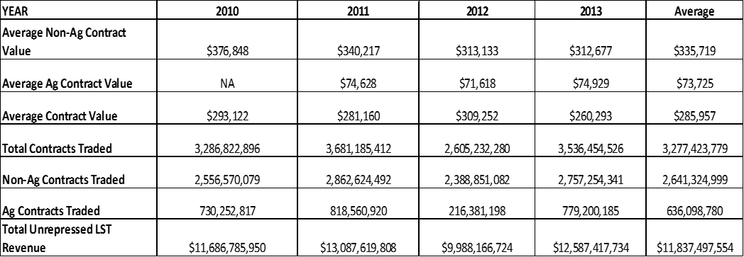
La Salle Street Tax Revenue Estimates 2010 – 2013
Source: Figure 1, “Chicago and Illinois already have one of the Largest Casinos in the World: We don’t need another Casino, We need to Tax the One We Have!,” June 15, 2015, Ron Baiman and Bill Barclay, CPEG: http://www.cpegonline.org/wp-content/uploads/2015/06/Chicago-Doesnt-Need-Another-Casino_Final_2.pdf

Slide 9
Feasible

Slide 10
Traders Cannot Move Because of “Collective Action” Problem
Moving trading liquidity from one market to another would be a difficult achievement, defying the classic collective action problem.
To induce an individual trader to move, there must be a critical mass of other traders to trade with. A large number of traders must move together for there to be adequate “liquidity” at the new exchange to support trading.
Once one exchange has captured all, or most of, the volume in a product, later entry of another Exchange is extremely difficult even when such an effort is backed by major financial institutions. An LST can be designed to apply only to products traded exclusively, or almost exclusively, in Chicago.
The 2011 failure of the Atlanta based Electronic Liquidity Exchange (ELX) that charged $ 1.25 - $2.00 less in transactions fees than the CME/ CBOT and CBOE is an example of this.

Slide 11
Exchanges Cannot Move Because of “Co-Location”
The expense of relocating all the hard-wired trading infrastructure would have to be justified economically, and a critical mass of affected traders, especially “High Frequency Trading” (HFT) firms and the exchanges would have to collectively organize to move all their switches and lines together.
For example, the CME facility in Aurora is the size of 7.5 football fields. The CME and other exchanges rent out space to HFT “co-Locators” to place their serves as close as possible to the “matching engine”. If the CME moved its matching engine it would violate its contracts with HFT co-Locators unless it moved and rewired all of the co-locators as well.
Other “co-location” facilities” are used throughout the Chicago Metro area, as are Exchange clearing house operations and necessary financial institutions and infrastructure. For example, another CME facility on Cermack in Chicago advertises that it has over 170 miles of fiber optic cable.
But even this would not offset the cost, as such a move would also create a major disruption in straight-line fiber-optic and micro-wave transmission trades from NYC and NJ matching engines that process directly through Chicago exchange matching engines leading to losses of tremendous value to traders (see Flash Boys by Michael Lewis).

Slide 12
The State Can Negotiate a Reasonable LST
Our policy preference, like that of many other Financial Transactions Tax (FTT) advocates would be use the LST to repress HFT trading.
However, if the CME/ CBOT and CBOE, were willing to provide detailed trading data (not currently publicly available), an LST could be tiered against holding time to reduce volume suppression and profit loss to the exchanges and HFTs.
For example contracts held for less than a minute could be assessed a fee of $ 0.10 or less. This loss of revenue could be made up with slightly higher fees for contracts held for over a minute, while still encouraging longer term trading by rebating all or part of the LST fee for contracts held for longer periods of time.
Such a modified LST rate structure could still generate billions in revenue for Illinois and Chicago.

Slide 13
Beneficial

Slide 14
LST Would Benefit Non-HFT Traders
Baron et. al. (2012), referenced above, finds that:
HFT firms don't trade much with each other, such HFT-HFT trades represented only 18% of total HFT trading volume.
HFT firms make profits from other market participants so an LST that reduced HFT Trading would lead to increased profits for non-HFT traders.
On balance HFT firms take rather than provide liquidity. The latter point suggests that HFT - non-HFT trading would simply be replaced by non-HFT – non-HFT trading if HFT traders were not available. HFT traders do not “hold positions” but mostly close their books at the end of the day.
Also, numerous law suits, including one currently pending against CME, accuse HFT traders of engaging in illegal “spoof” or “wash” trading, and there is no question that HFT’s use location and speed advantage to take advantage of other traders, including non-speculative traders hedging economic risks, the presumed “real” benefit of derivative trading.

Slide 15
Illinois Absolute and Relative Expenditure Shortfalls by Category of Expenditure (FY 2013)

Slide 16
Compared to our Midwestern Neighbors % GSP/capita Spent on Core Public Services
Minnesota 4.84%
Wisconsin 3.78%
Indiana 3.80%
Iowa 2.96%
Ohio 2.91%
Missouri 2.18%
Illinois 2.04%
Michigan 1.43%
Source (slides 15 and 17): “The People’s Agenda: A Path Towards Economic Prosperity for Illinois’ Families,” Grassroots Collaborative, Chicago Illinois, 2016: http://thegrassrootscollaborative.org/sites/default/files/ThePeoplesAgenda.pdf

Slide 17
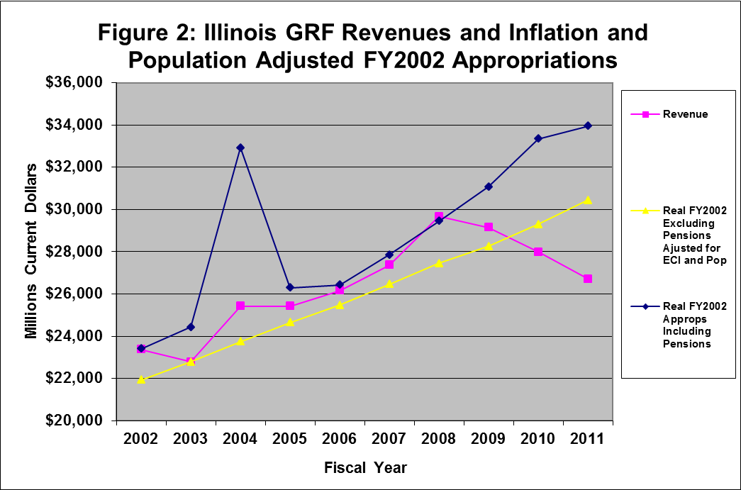
Illinois’ Structural Deficit
Source: http://www.ctbaonline.org/sites/default/files/reports/ctba.limeredstaging.com/node/add/repository-report/1385495360/R_2010.10.29_FINAL%20Funding%20Our%20Future-CTBA%20Report%20.pdf

Slide 18
Minnesota’s High Road
A good example of how forwarding a people’s agenda has revitalized a state’s economy is Minnesota.
Under Governor Mark Dayton, Minnesota passed several key policy reforms, and has steadily grown their economy since 2010.
They raised taxes on the wealthiest 2%, generating $1.13 billion in new revenue, increased state funding to education by $485 million, and increased renter and childcare tax credits.
Minnesota’s employment growth increased by 4.8%, and their unemployment rate decreased by 3.1%. And in 2016, they expect a $1.9 billion surplus.
Others agree that Minnesota is on the right track, and that high-road economics are sound economics. CNBC voted Minnesota America’s Top State for Business in 2015.

