Slide 1
A LaSalle Street Tax Could Save Illinois and Chicago Budgets, and Clean Up the Exchanges
Presentation to:
Community Forum: The Illinois Budget Crisis, Workers’ Rights and Revenue
July 19, 2015
Prisco Center, Aurora, IL
Dr. Ron Baiman
Benedictine University and
Chicago Political Economy Group
rbaiman@cpegonline.org

Slide 2
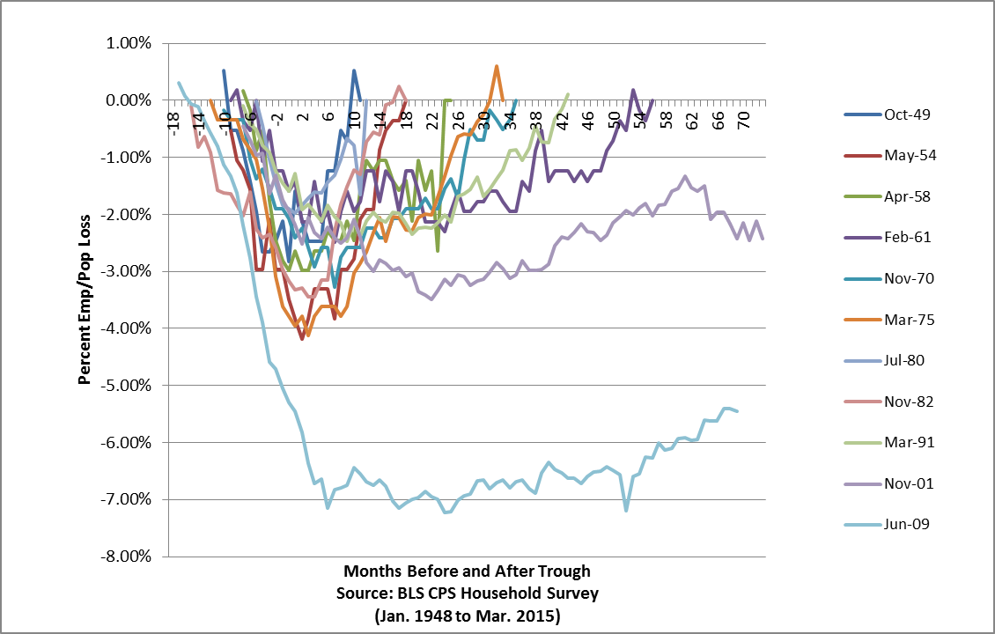
Employment Impact of the “Lesser Depression”: Post-War Recession Unadjusted Emp/Pop Ratios

Slide 3
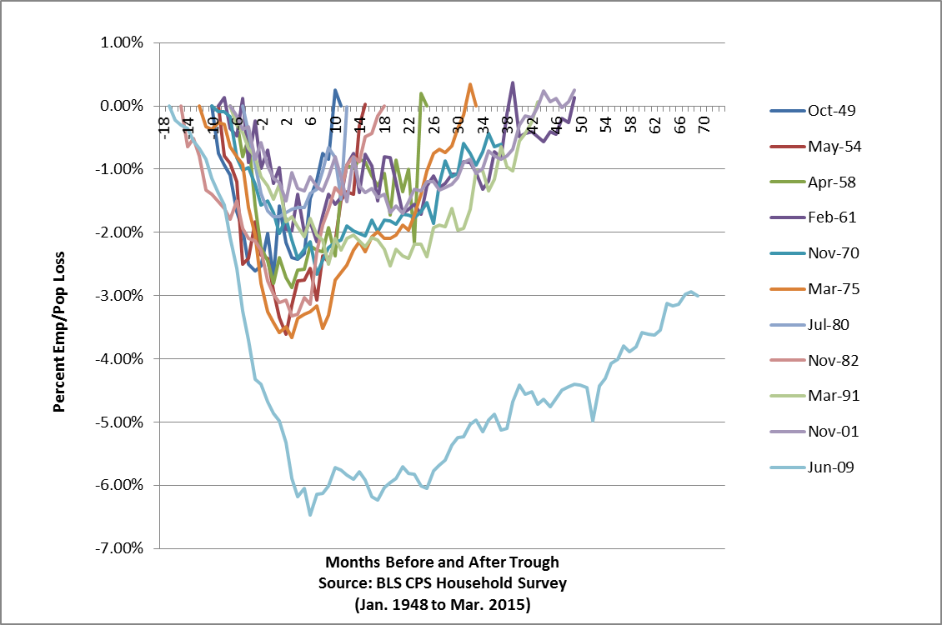
Private Sector Growth Won’t Lead to Lead to Real Recovery

Slide 4
Illinois’ Long-Term Structural Deficit

Slide 5
More Austerity is Not the Answer!
For decades Illinois’ inflation and population adjusted revenue growth has fallen short of even flat funding of state services.
And even this flat funding of state services is very low relative to the state’s capacity.
In 2012, Illinois was 12th per-capita income but ranked 28th in General Fund spending on services per-capita and 36th in General Fund spending as a share of state GDP.
This in spite of deferring payments and borrowing to fund state pensions that are not overly generous but low relative to other states.
Only 7% of the 1995-2013 change in unfunded pension liability is due to salary or benefit increases, 48% of this is due to borrowing from contributions.
In 2007 (before recent state pension cuts) Illinois’ Comptroller reported that IL ranked in the bottom fifth of all states in retirement benefits paid to the average state worker.
Source: Data in Center for Budget and Tax Accountability (CTBA) reports.

Slide 6
Wisconsin’s Anti-Union Austerity Approach
Gov. Rauner has lauded “the principles” and is following the policies of Gov. Scott Walker of WI.
At its lowest point after the 2008 start of the current “Lesser Depression” WI had a $3.6 billion budget deficit and unemployment rate of 9.2%. Specifically:
Wisconsin reduced spending on education;
Shifted costs of health care and pensions to state employees;
Reduced taxes on high income households to attempt to stimulate investment and job creation;
Became a “right to work” state, believing this would attract investment and increase job growth;
Rejected the Medicaid expansion offered under the Affordable Care Act
Gov. Walker spent much time and political capital attacking unions, especially public sector unions.
Source: “Rauner’s Run Aground Agenda,” Bill Barclay, CPEG Notes 1(2) May, 2015.

Slide 7
Minnesota’s Pro-Working Families Approach
Under the leadership of Gov. Mark Dayton, Minnesota also took a series of steps in response to the ravages of the Lesser Depression
At its worst point the Lesser Depression left MN with a $2.6 billion budget deficit and unemployment rate of 8.3%.
Minnesota increased state spending for education, especially at the post-high school level;
Increased state spending on job training;
Increased the tax rates for higher income households (for households receiving over $250,000/year. MN now has the 4th highest income tax rate of any state);
Increased the corporate income tax rate;
Took the Medicaid expansion offered under ACA;
Increased the state minimum wage to $9.00 (8/1/15) and then $9.50 (8/1/16) for businesses with $500,000 or more in annual sales and indexed it to inflation beginning in 2018;
Gov. Dayton worked with both public and private sector unions.
Source: “Rauner’s Run Aground Agenda,” Bill Barclay, CPEG Notes 1(2) May, 2015.

Slide 8
WI vs. MN: Fiscal and Economic Outcomes
Although Wisconsin’s labor force was a bit larger than Minnesota’s reflecting its larger population, Minnesota has created more jobs over the past four years than Wisconsin
Wisconsin still has a budget deficit. Minnesota has a budget surplus of $1.2 billion;
Wisconsin unemployment rate in March was 4.6% vs Minnesota’s 3.7%;
Minnesota’s pre to post Obama care uninsured rate fell by 34% more than double the 16% decline in Wisconsin and under Walker’s “Badger Care” it is estimated to cost the state $150 M to cover fewer people.
As of Oct 2014, manufacturing wages in Minnesota were $600/month higher than in Wisconsin.
Wisconsin personal income growth since the official end of the Great Recession has lagged that of the US as a whole (ranking 44th in the country), while Minnesota personal income growth has been faster than the US as a whole;
Wisconsin’s state GDP has grown by less than 2%/yr. in each of the past 4 yrs. while Minnesota’s state GDP has grown by over 2%/yr. and in 2010 by almost 4%.
Source: “Scott Walker has failed Wisconsin and Minnesota is the Proof,” by Jimmy Anderson, Milwaukee-Wisconsin Journal Sentinel on-line: http://www.jsonline.com/blogs/purple-wisconsin/280089862.html

Slide 9
The LaSalle Street Tax (LST)
A carefully designed very slight $1-$2 per-contract “LaSalle Street Tax” (LST) excise fee on some of the products traded at the CME, CBOT, and CBOE.
This fee that would still leave the overall cost of trading below what it was a decade ago, could generate up to $ 10-12 B for Illinois including $ 1-2 B for the City of Chicago.
Such an LST would not cause the traders, the exchanges, or their switches to move out of state for the following reasons.

Slide 10
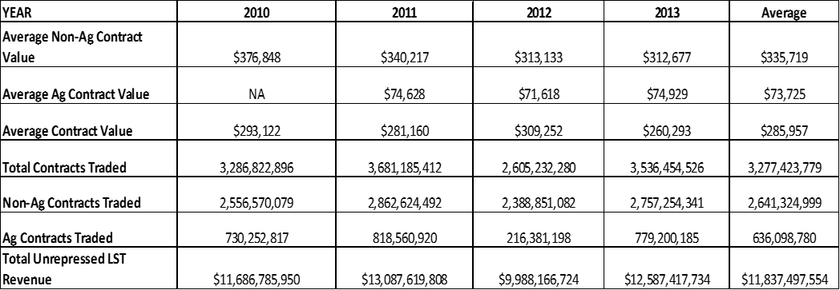
La Salle Street Tax Revenue Estimates 2010 – 2013
Source: Figure 1, “Chicago and Illinois already have one of the Largest Casinos in the World: We don’t need another Casino, We need to Tax the One We Have!,” June 15, 2015, Ron Baiman and Bill Barclay, CPEG: http://www.cpegonline.org/wp-content/uploads/2015/06/Chicago-Doesnt-Need-Another-Casino_Final_2.pdf

Slide 11
The LST Will Not Cause Financial Trading to Move Out of Illinois!
The CME Group, that owns the CME and CBOT exchanges, and the CBOE, would not pay the LST which is assessed on traders, not the Exchanges.
The products that are proposed to be taxed are not traded on any other exchange. Thus traders at the Chicago exchanges cannot currently trade these products anywhere else. Some of the products that would be taxed, such as the S&P 500 index futures and options, are exclusively licensed to these exchanges. While another exchange could seek regulatory approval to trade some of the other products, doing so would take a lengthy period of time.

Slide 12
Moving Trading Liquidity Requires “Collective Action”
Moving trading liquidity from one market to another would be a difficult achievement, defying the classic collective action problem.
To induce an individual trader to move, there must be a critical mass of other traders to trade with. A large number of traders must move together for there to be adequate “liquidity” at the new exchange to support trading.
Once one exchange has captured all the volume in a product, later entry is extremely difficult even when such an effort is backed by major financial institutions.
The 2011 failure of the Electronic Liquidity Exchange (ELX) that charged $ 1.25 - $2.00 less in transactions fees than the CME/ CBOT and CBOE is an example of this.

Slide 13
The LST Will Not Cause Chicago Exchanges to Move Their “Matching Engines” Out of IL
The expense of relocating all the hard-wired trading infrastructure would have to be justified economically, and a critical mass of affected traders, especially “High Frequency Trading” (HFT) firms and the exchanges would have to collectively organize to move all their switches and lines together at the same time without major disruptions to most of the traders for whom a $1 or $2 fee per trade would be at most an unnoticeable statistical error.
For example, the CME facility in Aurora is the size of 7.5 football fields. The CME and other exchanges rent out space to HFT “co-Locators” to place their serves as close as possible to the “matching engine”. If the CME moved its matching engine it would violate its contracts with HFT co-Locators unless it moved and rewired all of the co-locators as well.
But even this would not offset the cost, as such a move could cause the $ billions in investment in straight-line fiber-optic and microwave transmission from NYC and NJ matching engines directly to Chicago exchange matching engines to become kinked leading to milli or nano second losses of tremendous value to HFT traders (see Flash Boys by Michael Lewis). Alternatively, new transmission lines would have to constructed at great expense.
Finally, such a move would have to be justified to Non-HFT traders who might welcome getting rid of the HFT traders as in a “zero sum trading casino” they likely lose much more money to HFT traders than they would from a negligible (for non-HFT traders) $1 or $2 LST.

Slide 14
Financial Transaction Taxes Have Not Led to Volume Suppression
The amount of the proposed LST is less than the smallest price change or “Tick Size” (the smallest amount a trader could gain or lose on these contracts) so it would provide very little incentive for traditional traders to trade elsewhere even if the same products were available on another exchange. The $ 1 or $ 2 dollar increase in fees for traders would leave the trading commissions charged well below where they were only a decade ago and there is no indication that trading was suppressed at that time.
There are Financial Transactions Taxes on various financial markets in the United Kingdom, Switzerland, Hong Kong, Brazil, France, Singapore and other countries; in most cases the tax is at a higher rate than proposed under the LST (HB 0106). These are all large markets that have not been hurt by the tax and exchanges have not moved away. The one case, often cited by Financial Sector Lobbyists, where the tax was repealed due to volume suppression, is that of Sweden, where a relatively high financial transactions tax was imposed on a small exchange trading in products for which traders had numerous other lower tax exchange options.

Slide 15
Smallest “Tick Sizes” for LST Taxable Products
Source: Figure 2, “Chicago and Illinois already have one of the Largest Casinos in the World: We don’t need another Casino, We need to Tax the One We Have!,” June 15, 2015, Ron Baiman and Bill Barclay, CPEG: http://www.cpegonline.org/wp-content/uploads/2015/06/Chicago-Doesnt-Need-Another-Casino_Final_2.pdf

Slide 16
A Final Point
Our policy preference, like that of many other Financial Transactions Tax (FTT) advocates (see for example: http://www.nytimes.com/2015/07/22/opinion/the-case-for-a-tax-on-financial-transactions.html?_r=0 ), would be use the LST to repress HFT trading.
However, if negotiators of a proposed local FTT, or LST, believe that the LST might cause HFT repression significant enough to cause the CME/ CBOT and CBOE, and all of their co-located HFT servers, to relocate their switches out of state, the LST could be tiered against holding time to reduce volume suppression and profit loss to the exchanges and HFTs.
For example contracts held for less than a minute could be assessed a fee of $ 0.10 or less. This loss of revenue could be made up with slightly higher fee’s for contracts held for over a minute, while still encouraging longer term trading by rebating all or part of the LST fee for contracts held for longer periods of time.
Such a modified LST rate structure could still generate billions in revenue for Illinois and Chicago.

