Slide 1
China in the 2020s
Is the East Still Red?
BARCLAY - Draft of 12/3/2023 – based on CPEG discussion of 11/2023

Slide 2
Outline
PRC GDP 1970s forward
Growth Model
Sources of PRC GDP growth
Indicators of a slow down in the 2020s?
Economics
Cultural Indicators of a slow down
Political
PRC Housing Market
Dimensions
Largest housing market in the world
Transformation of shelter in PRC
Empty houses
Country Garden, Evergrande (and other property developers)
Paths forward?
Mainstream analysis
Alternative perspectives
Pettis/Roberts as e.g.

Slide 3
PRC Real GDP Growth 1980 - 2022
Beginning in 1978 real GDP doubled every decade – until GFC
Growth continued but at a slower pace
PRC Growth Model: Major drivers
High investment share of GDP
Over 40% annually
Consumption suppressed
Large export volume of manufactured products
Rural migration into cities
From low productivity sector to mid productivity level
Increased numbers of workers at low wages
Incoming FDI
Domestic result: huge increase in per capita income
Global result: in 2010s PRC accounted for over 40% of global GDP growth
US 22 %; EU 9%

Slide 4
PRC Real GDP Growth, Annual Percent, 1980 - 2022
2007
Tiananmen
Sq
Notes:
Source: Calculated from “Rising Age Gap in Economic Well Being: The Old Prosper Relative to the Young,” Pew Research Center, Nov 2011.

Slide 5
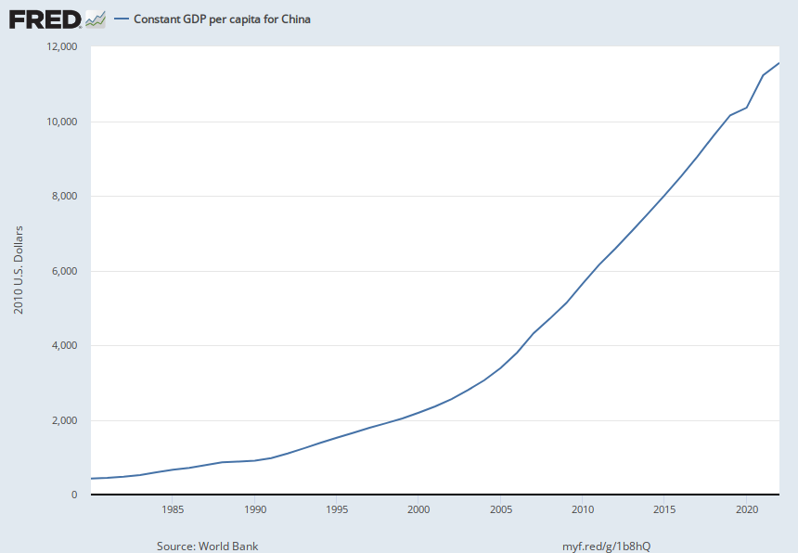
An historically unprecedented per capita growth over four decades
Notes:
Source: World Bank Release: World Development Indicators Units: 2010 U.S. Dollars, Not Seasonally Adjusted Frequency: Annual GDP per capita is gross domestic product divided by midyear population. GDP is the sum of gross value added by all resident producers in the economy plus any product taxes and minus any subsidies not included in the value of the products. It is calculated without making deductions for depreciation of fabricated assets or for depletion and degradation of natural resources.World Bank national accounts data, and OECD National Accounts data files. World Bank, Constant GDP per capita for China [NYGDPPCAPKDCHN], retrieved from FRED, Federal Reserve Bank of St. Louis; https://fred.stlouisfed.org/series/NYGDPPCAPKDCHN, November 7, 2023.

Slide 6
An Historically Unique Experience
PRC GDP growth over a 4-decade period unmatched
Exceeded even Japan and S. Korea
Prior to 2022 - only 3 years with GDP real growth below 5%
Per capita economic growth also unmatched
A Social Compact
CCP promised rapid improvement in economic well being
In return, the CCP asked for political loyalty
At times conflict - e.g., Tiananmen Sq - 1989
But the compact has largely held
Note: rate down shift after GFC
9.9% average vs 7.1% post GFC

Slide 7
PRC Growth Model - Fixed Infrastructure Investment: I
Fixed Investment % of GDP 45% annually 2000 – 2022
Basic infrastructure:
Roads and bridges
Transportation systems – e.g., light rail, subways
Schools, other public spaces
Houses
Structures
Office buildings
Factories
Debt financing for both SOE and private infrastructure investment
PRC total debt/GDP ratio: 273% in 2022

Slide 8
PRC Growth Model – Low Household Consumption
PRC priorities have suppressed household consumption
Personal consumption expenditures have been as low as 30 – 35% of GDP
Declined as share of GDP over the past 25 years
Despite Premier Wen’s 2009 call for increased consumption
Significant decline in the 1980 – 2010 period of rapid GDP growth
Increased somewhat 2011 – 2021: est. from 34.5% to 38.2%
Economist Magazine piece argued that official data omits many “social transfers” that would significantly increase household consumption share
But PRC would still be on the low end of this data globally
Remains very low by global standards
Global average personal consumption share of GDP is about 60%
Exports have made up much of the difference

Slide 9
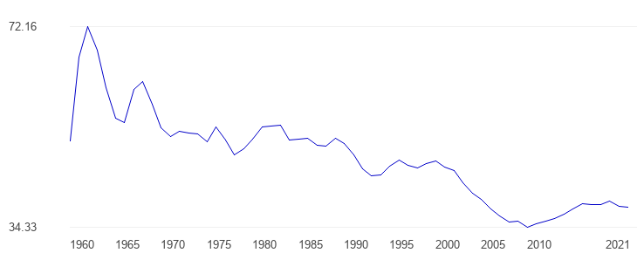
PRC: Household Consumption Share of GDP

Slide 10
PRC Growth Model: Exports
China became part of WTO in late 2001
Beginning of second large export increase
1985 forward exports/GDP grew – prior to WTO admission – neared 20%
In years after WTO admission, this ratio reached 35% or more
Peak was during the GFC years
Now back to 20 – 25% range
Net contribution to GDP growth was uneven – and not as important as often believed
Have COVID supply chain problems limit this growth driver?
Does US/China competition limit future of this growth driver?
Rate of PRC exports to US declined, 2023 vs 2022, about 20%; rate of imports from US declined 6 – 7%

Slide 11
PRC Exports: 2000 vs 2022
2000 – total PRC Exports: $270 Billion
Electrical Machinery and Equipment – US$73 Billion (29.2% of total exports from China)
Textiles and clothing – US$49 billion (20% of total exports from China)
Miscellaneous – US$27 billion (10% of total)
2022 – total PRC Exports: $3.6 trillion
Electrical machinery, equipment: US$954.8 billion (26.6% of total exports)
Other Machinery including computers: $552 billion (15.4%)
Vehicles: $150.2 billion (4.2%)

Slide 12
PRC Exports as a Percent of GDP, 1985 - 2022
GFC
WTO
Notes:
Source: Calculated from “Rising Age Gap in Economic Well Being: The Old Prosper Relative to the Young,” Pew Research Center, Nov 2011.

Slide 13
PRC: Net Export Contribution to Real GDP Growth, 1995 - 2022
Notes:
Source: Calculated from “Rising Age Gap in Economic Well Being: The Old Prosper Relative to the Young,” Pew Research Center, Nov 2011.

Slide 14
PRC Growth Model: Rural to Urban Migration
Sometimes neglected factor
Economic growth can occur via:
Increased size of labor force
Increased productivity of existing labor force
Rural – urban migration accomplished both
Rural – Urban migration
In 1980 China’s urban population was less than 20%
In 2010 it was almost 50%; today more than 2/3rds of the population is urban
Ag sector employment declined
60% of total workforce in 1990
24% in 2022
A shift from low productivity sector to higher productivity sectors (manufacturing and services)

Slide 15
FDI Inflows –a Note
William A. Williams: America’s “long dream in Asia”
Xi Jinping’s meeting with US corporate leaders at AEPC conference
Inbound FDI went from 0% of GDP in 1980 to:
6.2% of GDP in 1993
4.4% in 2007 (GFC)
1.0% in 2022
Declining importance but absolute amount is still $180 billion in 2022
However, recent estimate: outflow of $100 billion in first 9 months of 2023
Major break with past if this continues

Slide 16
Summary of PRC Growth Model 1980 – 2020s
PRC “proved out” the Japanese and South Korean growth model
But on a much larger scale because of size
A centrally planned economy can produce very high levels of growth for significant periods of time
Question today: has this growth model reached its end?
Debt/GDP ratio underlines this question
Private sector debt/GDP ratio approaching 200%
Major shift after GFC

Slide 17
A Slowing Economy? A Less Productive Growth Model?
Suddenly – or maybe not so suddenly – questions of sustainability are being raised
One week of headlines:
IMF: “Banks and Housing Threaten China’s Economy” (NYT 11/8/2023)
“China Shifts to Lending for Bailouts” (NYT 11/8/2023)
“After Building Up China, They Have Nothing to Fall Back On” (NYT 11/1/2023)
“Lying Flat” – movement of relatively well-positioned youth to “opt out” of struggle for workplace advancement
Youth unemployment: 21% today vs 11% in 2019
Producer Prices deflated for 13 consecutive months
House prices down 15% of more in Tier 2 and 3 cities
But IMF still projects 2023 GDP growth of 5.4%

Slide 18
Housing the Chinese Family
About 475 million households in PRC
Largest housing market in the world
The last four decades have been transformative for the PRC housing market and Chinese families
As noted earlier, most families are now urban
Rate of household formation is declining
Population growth has slowed
Male/female sex ratio constrains new family formation
Housing market is essential for understanding current econ problems/possibilities
Financial, institutional and cultural dimensions

Slide 19
Housing Market in the PRC: Share of Investment
Since 2000 real estate development investment has averaged one-third or more of total fixed investment
Housing “marketized” in 2003
End of in-kind housing provision in favor of market pricing for housing
Real estate development investment rose substantially
4% of GDP in 1999 to almost 15% in 2014
When industries linked to house building are included – about 30% of GDP
Cement – more poured in 3 years than in US in 2th century
Appliances, etc.
US max was 18% pre-GFC
Much of this growth driven by emergence of huge private sector developers
E.g., County Garden (largest developer); China Evergrande (impending bankruptcy?); Poly Real Estate; Vanke
Developer business model:
Fast construction
Leverage – borrowing from bank
Pre-sale of houses “to be built”
May pay 70% of cost before any cement has been poured

Slide 20
Housing Market in PRC: Transformation of Living
In 1980 most urban (and rural) Chinese lived in public rental housing
Today over 85% of urban households own their own homes
And 80% of those own “free and clear” – no mortgages
US: ownership share increased from about 40% to over 60% 1930s-1960s
70% plus of household wealth is in house ownership
Compare to 30-35% in US
Almost 25% of urban households own more than 1 home
Yet median house price/median income ratio now at all time high
Varies by city “Tier”
Tier 1 about 25:1 vs Tier 2 and 3 about 12:1 – sq. ft. cost similar to Boston
US now at all time high of 4.75:1
And house building goes on – 6.5 million houses built in 2022
Down somewhat from 2012 record of 7.65 million

Slide 21
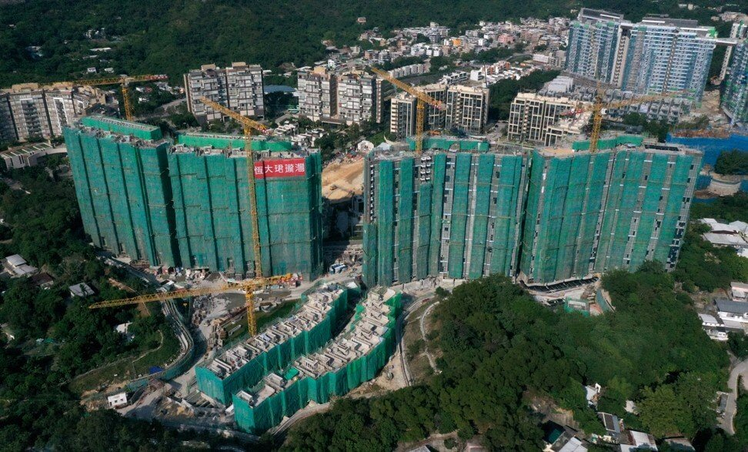
Prices at China Evergrand’s Emerald Bay project in Tuen Mun began at HK$3.2 million (US$400,000) for a 21 square meter unit.

Slide 22
Houses are for living in, not speculation
- Xi Jinping, 2017
But omitted from 2023 Politburo statement on the economy

Slide 23
PRC Housing Market Today: Empty Homes
1 of every 5 houses in PRC are not inhabited
About 65 million housing units are empty
Total US housing units: 143 million
However, almost all of these have owners
And more are still being built
6.5 million in 2022
Overbuilding, ghost towns and homelessness are coexisting
These ghost towns are not full of run down, dilapidated dwellings
Most are new and in good condition – although questions about the quality of construction persist
Construction quality questions
Chinese houses thought to last for 25-30 years vs 75 or more in US, Europe
What is going on?

Slide 24
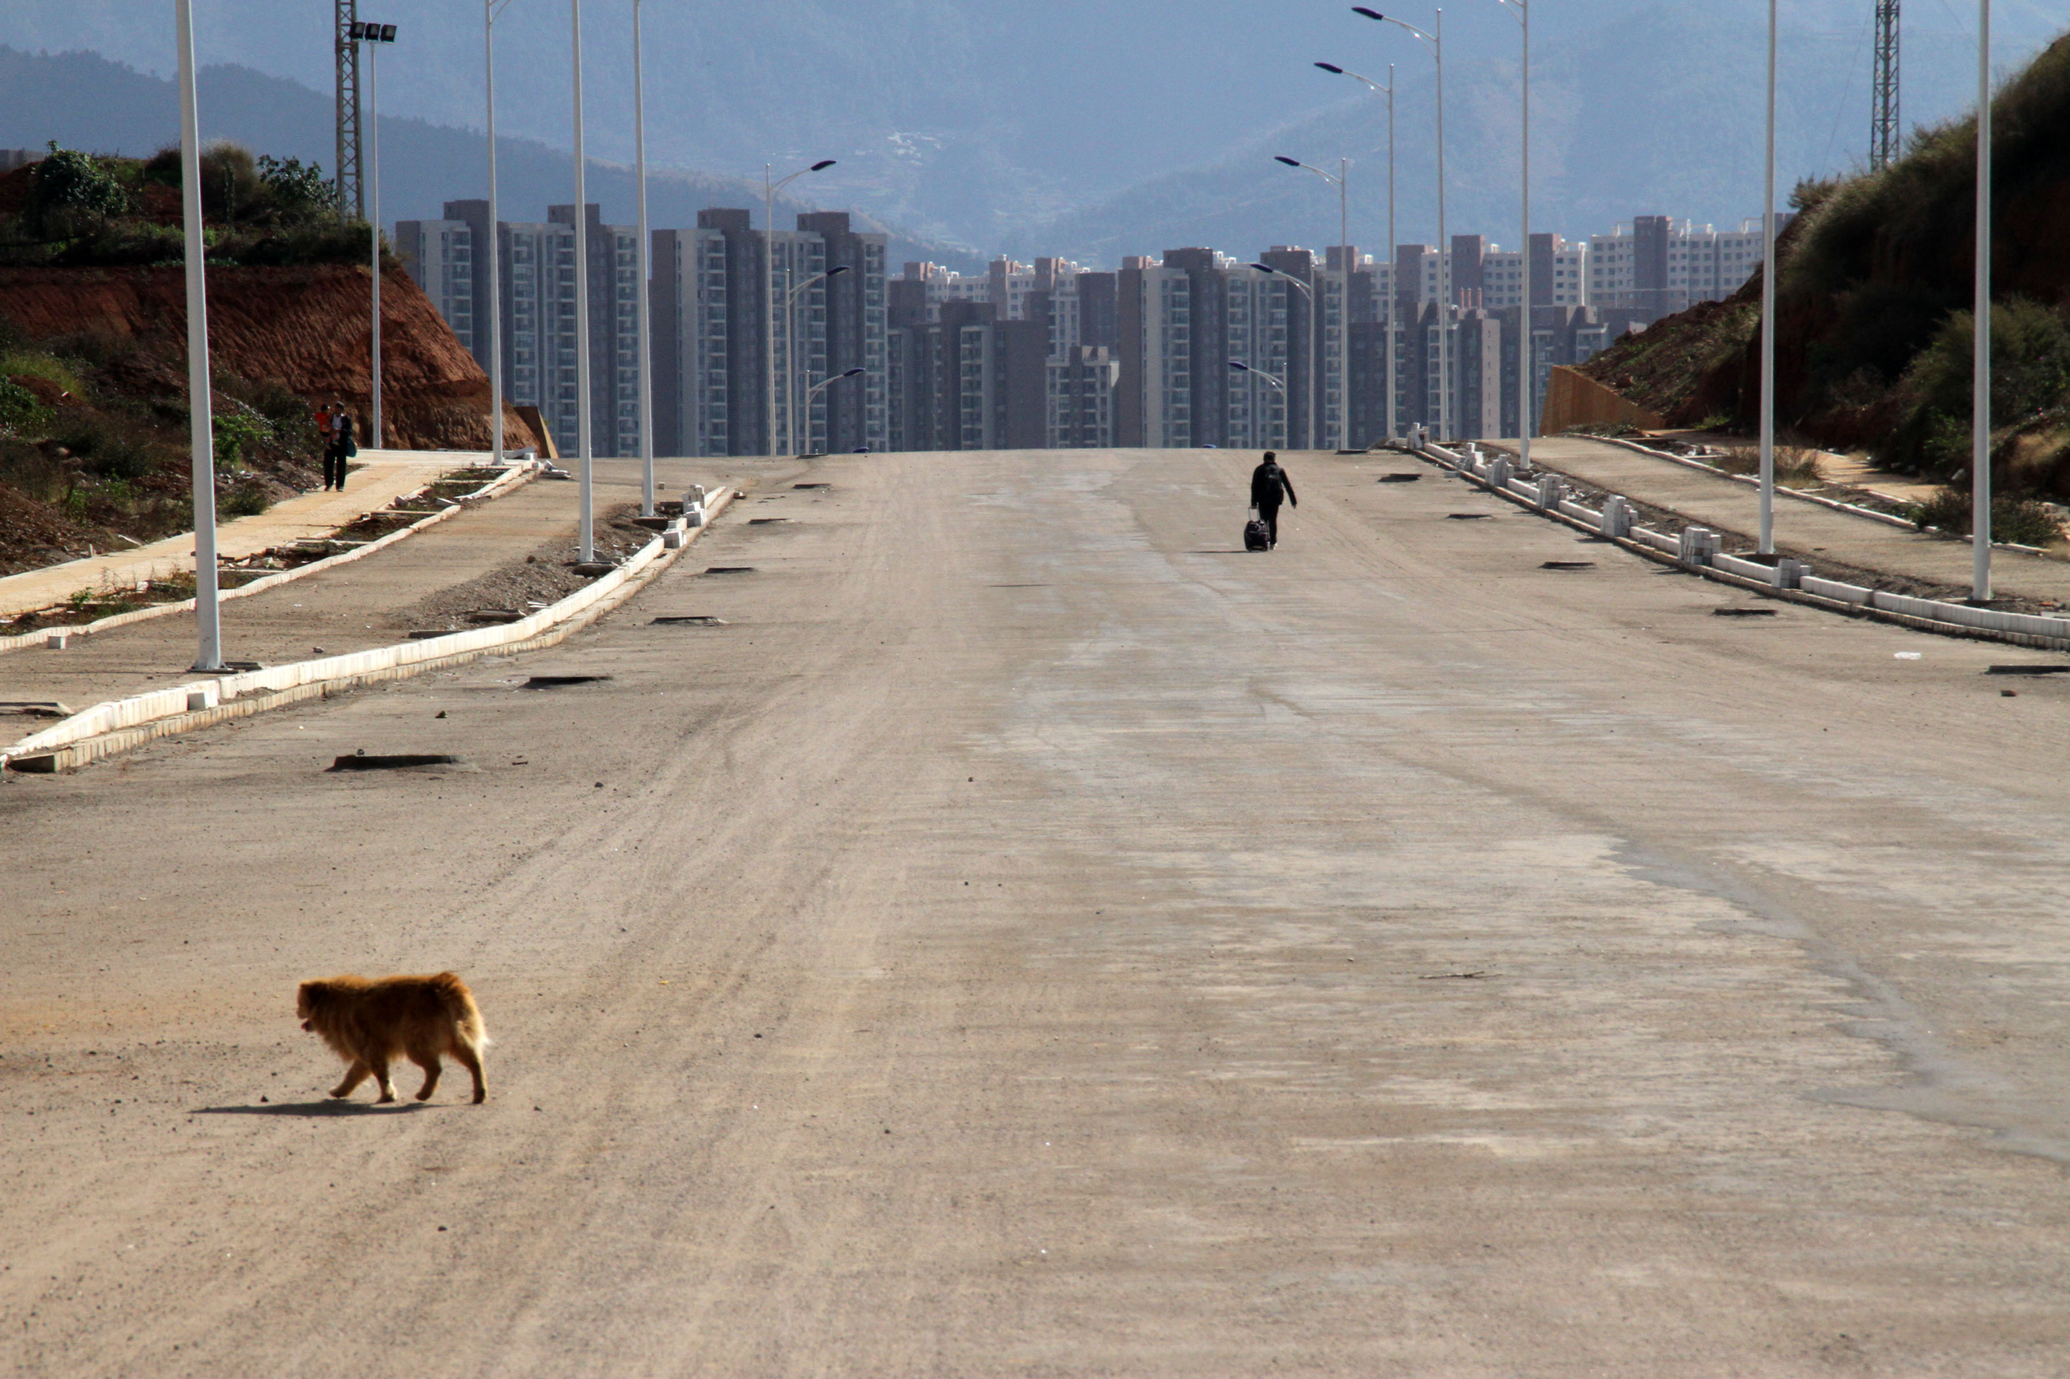
Empty streets, empty houses and buildings in Chenggong, Yunnan Province in southwest China

Slide 25
The Mystery of Multiple House Ownership in PRC
Obviously some – in fact many – families own multiple houses
And more are seeking to!
2017: 87% of all house buyers already owned a house (or more)
Who owns urban houses in PRC:
Influenced by hukou status
Over 90% of local residents (hukou) vs
79% of urban migrants and only 47% of rural migrants
Multiple home ownership is part of increased economic inequality in PRC
Why do families own more than one house?
There are economic but also institutional and cultural factors driving multiple home ownership
Look at these before turning to the question of impact on PRC growth going forward

Slide 26
Multiple Home Ownership in the PRC
Households that own multiple houses:
Higher income and wealth
Especially true for local residents – also more likely to own houses in different cities
Higher education
More likely to have children under 15
More likely to be in public sector jobs
Much less likely to be rural migrants
More likely to be relocated household
From large redevelopment/renovation of many cities
May be more common in aspiring “Tier 1” cities
City tier classification – unofficial

Slide 27
Why Do Families Own Multiple Homes: I
Economic drivers
Housing prices have increased more rapidly than income or other investment possibilities
Low interest rates on bank deposits – to help fund developers
Very hard to invest abroad
Chinese stock market not trusted
Many multiple owners got first house at below market price when public rental housing sold
Relocated families offered houses
Institutional drivers
No cap on house purchases by urban (but not rural) migrants purchases in origin city
“Talent housing” – relocation incentives from Tier 2 and 3 cities

Slide 28
Why do Families Own Multiple Homes: II
Cultural drivers
Catchment areas for “key schools”
Requires residence established in these zones
Competitive marriage market
Unfavorable (for males) sex ratio
From 1 child policy
Overall 104.6 – but under 30 is 110 or more (global 102)
Families of potential brides seek guarantee that housing is established
What can the potential husband offer?
Given importance of non-economic drivers, gov. economic focused policies to discourage multiple ownership have limited impact
E.g., higher down payments and/or mortgage rates for 2nd and further homes
Will housing market prices change behavior?

Slide 29
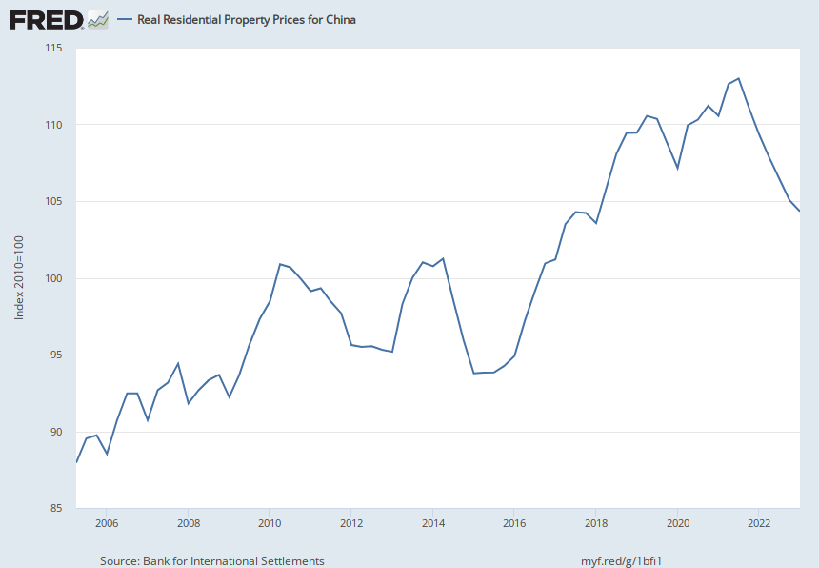
Housing prices have stopped increasing. 2010 = 100; today 104.3
Notes:
Source: Bank for International Settlements Release: Selected Property Price Series Units: Index 2010=100, Not Seasonally Adjusted Frequency: Quarterly Source Code: Q:CN:R:628Coverage includes Q1 2007-Q4 2015: New dwellings in 70 cities in China; from Q1 2016: Existing buildings in 70 cities in China. The series is deflated using CPI.For more information, please see https://www.bis.org/statistics/pp_detailed.htm.Any use of the series shall be cited as follows: "Sources: National sources, BIS Residential Property Price database, http://www.bis.org/statistics/pp.htm."Copyright, 2016, Bank for International Settlements (BIS). Terms and conditions of use are available at http://www.bis.org/terms_conditions.htm#Copyright_and_Permissions. Bank for International Settlements, Real Residential Property Prices for China [QCNR628BIS], retrieved from FRED, Federal Reserve Bank of St. Louis; https://fred.stlouisfed.org/series/QCNR628BIS, November 9, 2023.

Slide 30
Back to PRC Growth Model: Debt
PRC economic problems pre-date 2022
Are illustrated by housing market but are wider
Much of the rapid GDP growth has been debt driven
Effective for financing basic infrastructure needs
Last 15 years the debt/GDP ratio has accelerated
Now one of highest globally
Debt growth at:
National level
Debt/GDP ratio 2x since GFC
Local government level – especially LGFV (local government funding vehicles)
Non-financial corporate

Slide 31
PRC: Central Gov Debt/GDP Ratio 1995 – 2022
GFC
Notes:
Source: Calculated from “Rising Age Gap in Economic Well Being: The Old Prosper Relative to the Young,” Pew Research Center, Nov 2011.

Slide 32
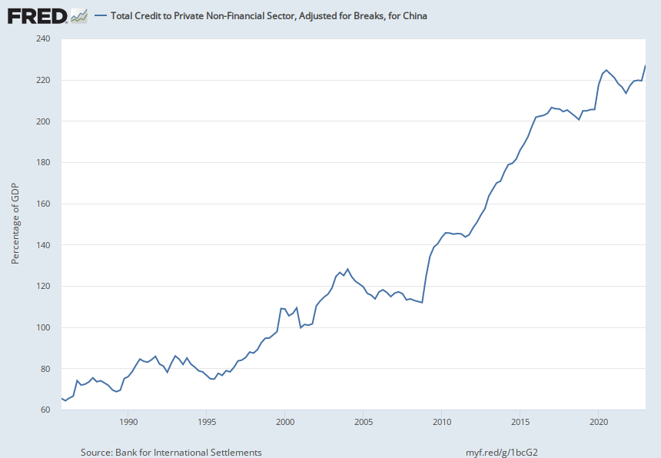
PRC: Private Sector Debt to GDP, 1985 - 2022
Since 2007 Private sector Non-Financial Debt/GDP ratio has more than doubled since GFC
2022: 227
GFC
2007: 112
Notes:
Source: Calculated from “Rising Age Gap in Economic Well Being: The Old Prosper Relative to the Young,” Pew Research Center, Nov 2011.

Slide 33
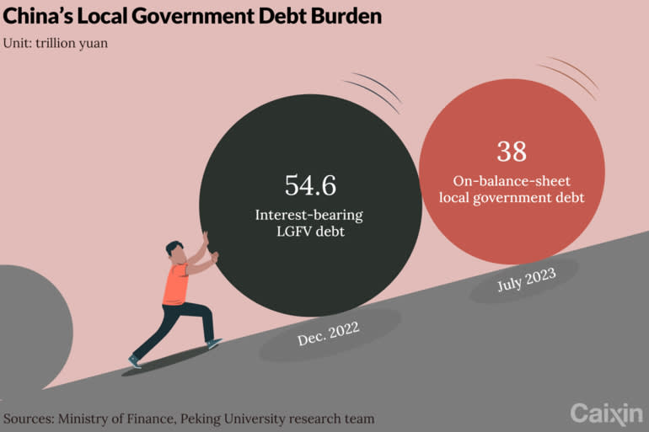
Yuan/dollar exchange rate: 7.25:1; 38 trillion yuan = $5.25 trillion

Slide 34
Digression: Two Housing Bubbles
US had a housing bubble leading into GFC
PRC has a not yet burst housing bubble
Similarities
Increased amount of debt financed the boom
Quality of the debt declined (even if S&P and Moody’s didn’t see it)
Overbuilding occurred in both cases
Vacancies grew – but much more in PRC case
Differences
Size of residential real estate sector to GDP
Max 18 % in US vs 30% in PRC
What entities hold the debt and are at greatest risk
Banks, SPVs, international investors etc in US vs LGFVs, domestic holders for PRC debt
Who owes the debt
Households in US – foreclosures
Gov and semi-private enterprises in PRC

Slide 35
Path(s) Forward? The Debate: I
Tooze: regime dead end vs exhaustion of growth model
Posner (PIIE) vs Pettis (Prof Finance at Peking U.)
Posner identifies two systemic problems
Lack of rule of law in SOE sector
Arbitrary decisions at central gov level (Xi JinPing)
Results:
Can’t sustain long term GDP growth
Households favor saving over consumption because of socio-economic uncertainty
PRC to be stuck at mid-level country level unless:
Regime provides more latitude for markets
West (US) should see an opportunity to move PRC in favorable political and economic direction
Little attention to housing market or debt

Slide 36
PRC Growth and Debt
Debt/GDP ratio has risen dramatically
May understate – “hidden debt”
Much is result of LGFV bond issuance
Why is there hidden debt at the local gov level – back to housing market and infrastructure driven growth model
No residential property tax (a few short lived experiments)
Local government revenues dependent on:
Land sales to developers – incentive for more building
Property related development taxes
Local government finances parks, roads, subway stations, etc.
Fixed assets that were needed in 1980s forward
Today many do not return the funds invested
60% of LGFVs can’t meet interest payments

Slide 37
Paths Forward: II
Change composition of GDP toward consumption
Proposed 2007 and later – little has actually happened
Shift from non-productive to productive investment
Could SOEs lead in terms of new tech – climate control, etc?
Two problems
Entrenched interests favor existing growth model
Could new sector(s) absorb 15% or so of GDP?
Bubble continues – until collapse
US in 1920s followed by Great Depression
Japan 1970s/80s forward

