Slide 1

Economic Crisis Workshop
Chicago Political Economy Group
December 2009
Bill Barclay

Slide 2
How Serious is this Economic Crisis:
Some Dimensions
Jobs lost: 12/07 – 11/09 = 8.0 million
  9.7% officially unemployed, Jan 2010 (14.8 million)
  18.3% if include “hidden” unemployed: (working part time/want full time = 8.3 million) + dropped out of labor force because don’t believe jobs are available: 6.0million): 29.1 million official plus “unofficial” or 18.3%
Foreclosures: >800,000 in 2008, 3.1 million foreclosure notices; in 2009 1 foreclosure every 13 seconds (24/7) = 2.4 million, 1 in 10 may face foreclosure
20% decline in household net worth in 2008/09 (loss of $13 trillion in wealth)
“Big Three” auto companies teetered on edge of bankruptcy
US GDP fell at an annual rate of 6.2% in last quarter of 2008
Stock market dropped 55% Oct 2007 – March 2009
On all measures this is the most severe economic collapse since the 1930s

Slide 3

Was it just an Accident?

Slide 4
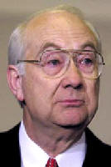
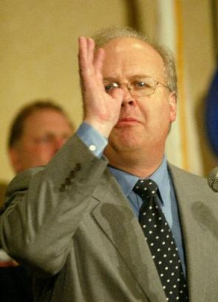
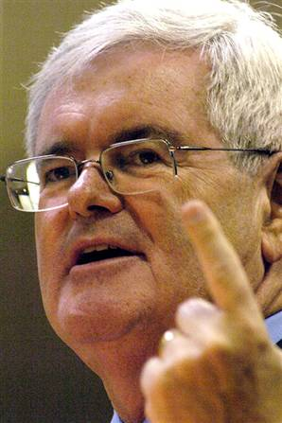
You've heard of mental depression; this is a mental recession…we have sort of become a nation of whiners.
- Phil Gramm
Karl Rove
Newt Gingrich

Slide 5
How Did We Get Here?
Three causes:
  Long term trend towards increasing economic inequality in the US
  Credit, Debt and Financial Deregulation
  Change in US Role in World Economy
Let’s talk about each

Slide 6
The First Cause
Growth and Impact of Economic Inequality

Slide 7
Inequality of Income in US
How much income inequality is there?
How has it changed over time?
We will answer these questions in two ways:
  First, we divide all US households into 5 groups ranked by average income (“quintiles”)
    Same number of households in each quintile (approximately 22,500,000 households in 2006 vs. 16,200,000 in 1979)
    Compare average after tax income in each quintile in 1979 and 2006, using 2006 dollars ($1 in 1979 = $2.78 in 2006)
    Each marker on the floor represents $5,000 or $10,000 of 2006 income
    Our quintiles will start by opening their 1979 envelope and walking to the marker (or space in between markers) that represents the average income for that quintile in 2006 dollars for 1979
    The top 1% of households by income will also walk to the appropriate marker
    After we see where we all are in 1979, each quintile and the top 1% will then open their second envelope and walk to the appropriate marker as I call their quintile

Slide 8
Change in Income Shares in the US
Next, we will look at what portion of total household income each quintile received in 1979 and 2006, again in 2006 dollars
Total US household income in 2005 was approximately $11.3 trillion (in 1979 it was $2.2 trillion)
  First, we again divide all US households into 5 groups ranked by percentage share of total income received
    Again, same number of households in each group (approximately 22,500,000 households in 2006 vs.16,200,000 in 1979)
    Compare percent of total income received by each quintile and the top 1% of all families by income in 1979
    Our quintiles will start by opening their 1979 envelope and walking to the appropriate marker for their income share in 1979
    The top 1% will also walk to the appropriate percentage marker and will then take their income share from the top quintile (they are part of the top quintile)
    After we see the income shares received by each, the quintiles and the top 1% of households will open their 2006 envelopes and move to the appropriate percentage marker as I call their quintile

Slide 9
Average Income by Quintiles and Top 1%, 1979 and 2006 (2006 $)

Slide 10
Percent Income Shares by Quintiles and Top 1%, 1979 and 2006
2005 Distribution
1979 Distribution

Slide 11
Results of Increased Economic Inequality
Rapid increase in top incomes has also shaped our politics and our culture
  Directly: Large donors have more to give to political campaigns and thus have become more important
  Indirectly: Wealthy families have founded and funded research institutes and think tanks and reshaped the universe of political discourse
    Labor and community groups became less influential

Slide 12
The Impact of Growing Economic Inequality:
The Average Cost of Senate and House Campaigns

Slide 13
Redefining Politics and Policy: I
Heritage Institute founded 1973
  Important source of Reagan administration staff and policy including “evil empire” idea
    Worked with Newt Gingrich to develop “Contract with America”
    Developed “Laffer Curve” used by Reagan to justify lowering tax rates, especially on high income families
      Argued that it would increase economic innovation and growth and thus tax revenues – it did not do so
    With Wall St. Journal publishes the “Index of Economic Freedom” – Hong Kong and Singapore currently #1 & 2
      Concerned that US has dropped to 12th
        Cut corporate tax rates
        Privatize more government activities
        Reduce/eliminate tariffs on imports

Slide 14
Redefining Politics and Policy: II
Cato Institute established 1977
Barry Goldwater and Ronald Reagan credit Cato Institute with rejuvenating the GOP
  Project on Social Security Privatization created 1995 (renamed Project on Social Security Choice in 2002)
    Peterson Foundation – created “Fiscal Times” to attack Social Security, Medicare and Medicaid
  Global warming skeptic
  Awards Milton Friedman Prize for Advancing Liberty

Slide 15
Results of Increased Economic Inequality
Declining savings rates for most of US population – how do we keep up our standard of living?
  Increased use of credit to finance consumption
    The rise of credit cards
    The use of mortgage debt

Slide 16
“Put it on the Plastic:” Credit Cards
Where did credit cards come from?
  Diners’ Club – 1951; Bank America (VISA) 1958; MasterCard 1966
  First mass mailing: Bank of America in Fresno CA 1958
Supreme Court 1978 decision allowed credit card companies to charge the maximum interest rate in their home state to any card holder, no matter where s/he was
  ND removed interest rate cap (a “regulatory restraint”) and credit card issuers came
Credit card growth exploded
  2007: 173 million of us had credit cards, up from 159 million holders in 2000
  In 2008, 3.8 billion offers of credit cards were mailed in the US vs. 5.2 billion in 2007
    73% of US families had a credit card
    76% of college students had a credit card
    14% of credit card holders had 10 or more cards
    Average balance: $7,300
  Credit card debt only 3.5% of total household debt
    “Insistence on buying only what can be paid for in cash seems as outmoded as a crew cut” – Time Magazine, 1977

Slide 17
The Second Cause
Credit, Debt and Financial Deregulation

Slide 18
2003 Financial Situation
Total assets: $300,000 (house value)

Slide 19
2003 Financial Situation
Total assets: $300,000 (house value)
Total debt: $294,000 (mortgage)

Slide 20
2003 Financial Situation
Total assets: $300,000 (house value)
Total debt: $294,000 (mortgage)
Housing equity: $6,000 (down payment)
Monthly mortgage payment @ 5%: $1,225 (30.6% of monthly income)

Slide 21
2003 Financial Situation
Total assets: $300,000 (house value)
Total debt: $294,000 (mortgage)
Housing equity: $6,000 (down payment)
Monthly mortgage payment @ 5%: $1,225 (30.6% of monthly income)

Slide 22
2005 Financial Situation
Total assets: $350,000 (house value)

Slide 23
2005 Financial Situation
Total assets: $350,000 (house value)
Total debt: $320,000 (mortgage)

Slide 24
2005 Financial Situation
Total assets: $350,000 (house value)
Total debt: $320,000 (mortgage)
Housing equity: $30,000

Slide 25
2005 Financial Situation
Total assets: $350,000 (house value)
Total debt: $320,000 (mortgage)
Housing equity: $30,000
Cash in bank: $26,000

Slide 26
2005 Financial Situation
Total assets: $350,000 (house value)
Total debt: $320,000 (mortgage)
Housing equity: $30,000
Cash in bank: $26,000
Monthly mortgage payment @ 5%: $1,333 (30.2% of monthly income)

Slide 27
2007 Financial Situation
Total assets: $260,000 (house value)

Slide 28
2007 Financial Situation
Total assets: $260,000 (house value)
Total debt: $320,000 (mortgage)

Slide 29
2007 Financial Situation
Total assets: $260,000 (house value)
Total debt: $320,000 (mortgage)
Housing equity: -$30,000 (negative equity)

Slide 30
2007 Financial Situation
Total assets: $260,000 (house value)
Total debt: $320,000 (mortgage)
Housing equity: -$30,000 (negative equity)
Need additional cash payment: $60,000

Slide 31
2007 Financial Situation
Total assets: $260,000 (house value)
Total debt: $320,000 (mortgage)
Housing equity: -$30,000 (negative equity)
Need additional cash payment: $60,000
Monthly mortgage payment @ 7.5% if can’t raise $60,000: $2,000 (48% of monthly income)

Slide 32
Financial Regulation:
The New Deal
1933 Congress passed the Glass-Steagall Act
  Included Federal Deposit Insurance Corporation
  Contained the first federal minimum wage
  Divided financial institutions into distinct groups
    Commercial banks: take deposits (covered by FDIC), make loans to businesses and individuals
    Investment banks: underwrite and sell securities as broker-dealers (stocks, bonds), trade for own account, merger and acquisition
    Insurance companies

Slide 33


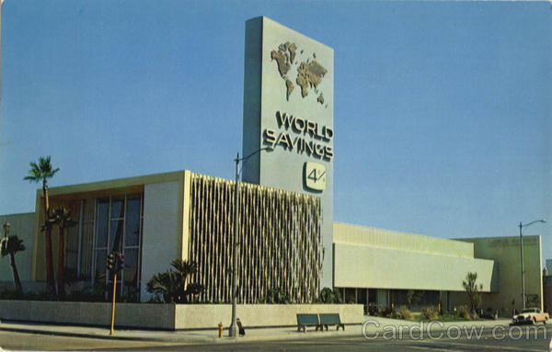
Glass-Steagall Act

Slide 34
What Happened to Glass-Steagall?
During 1980s financial institutions began lobbying to repeal the separation portions of Glass-Steagall
1998 Alan Greenspan (Fed Reserve Chairman) granted CitiGroup a temporary license to combine investment and commercial banking
  Expired in two years unless Glass-Steagall was repealed
  1999 Gramm-Leach-Bliley (yes, that Gramm) Act repealed the separation portions of Glass-Steagall
“One Stop Shopping” in the financial super-mall

Slide 35
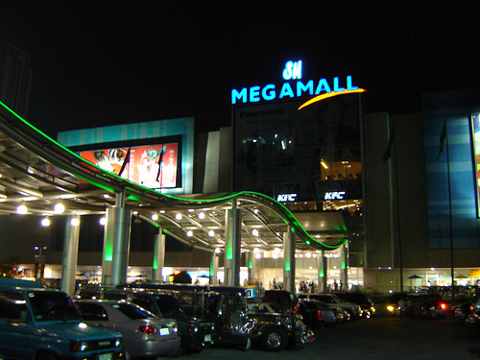



After Glass-Steagall Act’s Repeal → “one-stop shopping”

Slide 36
Home Ownership in the US

Slide 37
Mortgage Banking Model Changes
Mortgage banking used to be:
  Assess the financial standing of the potential home buyer
  Make a loan based on income and long term financial outlook
  Carry the loan in bank’s portfolio
  Incentive: risk averse
Repeal of Glass-Steagall opened door to very different model
  Review credit score
  Make a loan (“initiate” a loan)
  Sell (“distribute”) the loan for packaging into mortgage backed securities (MBS)
  “Securitization” of mortgages allows them to be sold to other investors
  Make the next loan
  Incentive: make as many loans as quickly as possible and get them out the door

Slide 38
Leverage
Leverage is a ratio
  Compares the value of an asset to the equity you have invested
    Consider our home buyers
      In 2003 they had leverage of 50:1 (house valued at $300,000 and a equity – a down payment - of $6,000)
      In 2005 they had leverage of 8.5:1 (house valued at $350,000 and equity of $30,000)
      The change between 2003 and 2005 shows the attraction of leverage: if they had sold they would have made $50,000 (the difference between the 2003 cost of $300,000 and the 2005 value of $350,000) on a $6,000 investment (their down payment); plus the 24 interest-only payments of $1225/month. Their total cost was $35,400 and there profit would have been $14,600 or 41.2% on a two-year investment
  Unfortunately, leverage also works when prices fall – you lose your equity very quickly

Slide 39
The Third Cause
The US and the World Economy

Slide 40
Problems for the US in the Global Economy: I
For several decades before and after WWII, US had been net exporter and the world’s largest creditor nation
US balance of trade turned negative in 1970s and current account turned negative in 1980s
  By mid 200s the current account deficit had increased to 6% of GDP, a level that is not sustainable
What was happening – in answering this question we will learn why the economic crisis is not just a US economic crisis

Slide 41
Industrial Policy: the US Case
US economic and political leaders normally reject the idea of an industrial policy
  Argument that the “market knows best”
  Argument that industrial policies “don’t work”
    Consider Japan, China, and Scandinavia
In fact, the US has had a de facto industrial policy
  Usually defined as “free trade”
    Let manufacturing go offshore
    Develop services, especially financial services
      Finance as a domestic economic leaders : until 1980s financial profits had never exceeded 20% of all corporate profits – reached >40% in mid-2000s
      Finance and balance of trade: US comparative advantage in financial services to drive exports
  Attempt to balance trade deficit via exporting of services, especially financial services
    It hasn’t worked (in case you haven’t noticed)

Slide 42
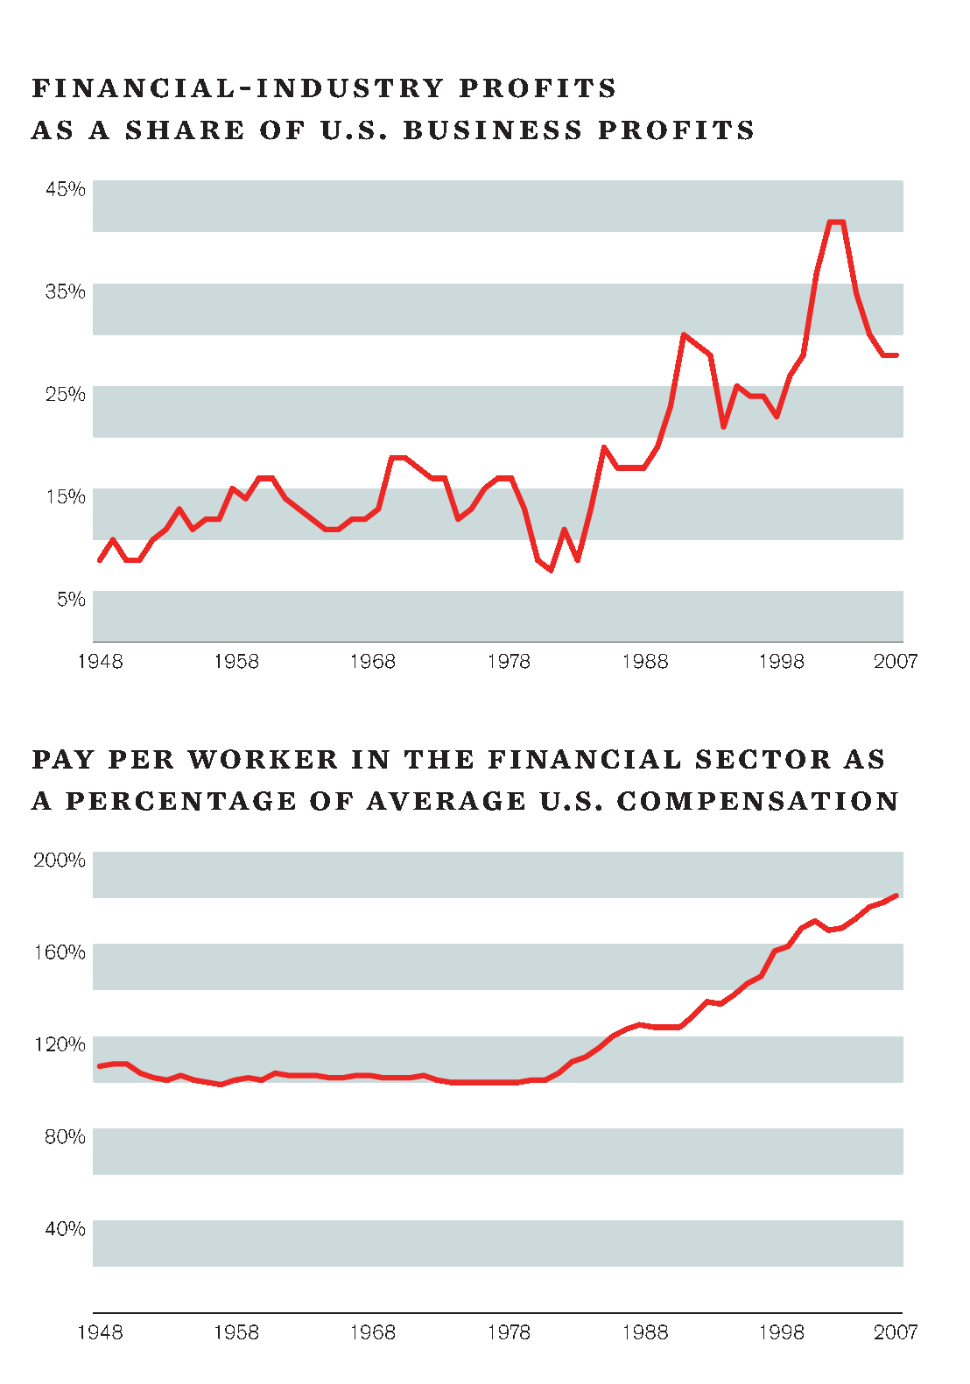
Dr. Wm Barclay - The Financial/Economic Crisis
42

Slide 43
US in the Global Economy
US dollar often referred to as the world’s “reserve currency” – what does this mean
  International trade often denominated in dollars
    Especially the single largest trade commodity: oil
    US has been able to run a trade deficit for many years
  Governments and individuals have been happy to hold dollars – can be exchanged for any other currency
  Dollar-denominated debt as “safe haven” in times of economic turbulence
    US can usually borrow very cheaply – US debt is (or at least has been) considered the safest in the world
    World wide market for US debt, both public and private

Slide 44
Globalizing the Housing Bubble
Deutsche Bank: 45% of US originated asset backed securities owned by non-US investors (2005)
  Total amounted to $3 trillion held by non-US individuals and institutions (1/3 of their total holdings of US assets)
  US MBS represented 8% of world total bank loans and securities
    A range of non-US institutions bought this debt - e.g Norway town, Iceland’s banks, etc
      At year end 2006, European banks alone had over $300 billion of MBS (almost 3.5 times their total profits in that same year)
Thus the financial impact became of the housing bubble, including its bursting – became world wide
  Other countries with similar housing bubbles, e.g. Spain, UK found themselves hit by both the collapse of the US housing bubble and their own

Slide 45
Problems for the US Dollar
Trade deficit undermines confidence in value of dollar
Long term decline in value vs. Euro and yen (somewhat reversed in last year)
  Foreign central banks have diversified holdings
  Some petroleum exports now denominated in other currencies
Is there something we could export that could help balance our trade flows?

Slide 46
Some Political and Economic Signposts
1973 Heritage Foundation established
1975 “Supply Side” Economics defined and labeled
1977 Cato Institute created
1982 – 3 Reagan tax cuts reduce top tax rate to 50% from 70%
1984 Rush Limbaugh starts broadcasting in CA
  1988 Rush Limbaugh moves to NYC and goes national
1987: Alan Greenspan becomes Chairman of Federal reserve
1999: Gramm-Leach-Blilely Act repeals portions of Glass Steagall
2001 Bush tax cuts reduce top tax rate to 35%
WHAT WAS THE CUMULATIVE EFFECT?

Slide 47
What is Neo-Liberalism?
Core tenet: markets are self correcting and provide the best (most efficient in use of resources) outcomes if allowed to function
  Markets bring together a large number of participants who vote with their dollars
Therefore:
  Remove regulatory “restraints” on markets – government-regulated outcomes are always “second best”
  Turn activities over to private sector wherever possible
  There is no “common good,” only individuals seeking their personal well being

Slide 48
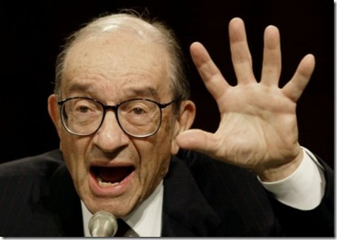

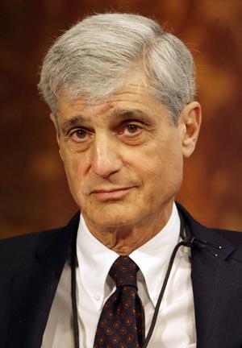

These new [financial] technologies lay off all the risk of highly leveraged institutions on stable American and international institutions.
- Alan Greenspan
Ronald Reagan
Robert Rubin
All the evils, abuses, and inequities, popularly ascribed to businessmen and to capitalism were not caused by an unregulated economy of by a free market, but by government intervention into the economy.
--Ayn Rand

Slide 49
What Can Be Done?
Ideas on Policies

Slide 50
Regulating the Financial Sector
Restrict leverage
  30:1 (or higher) leverage brought down Bear Sterns, Lehman Bros. etc.
  If you can’t make money at, for example, 15:1 you probably should go into another business
Extend regulatory power over all entities that create credit
  Commercial banks – remember them? – used to be the primary source of loans
  Now the “shadow banking system” of hedge funds, off-books entities, mortgage brokers – all largely unregulated – account for most of the credit
Break up entities that “are too big to fail” – sooner of later they will get the rest of us in trouble
Return to the Glass-Steagall division of financial activities

Slide 51
Develop a Jobs for All Program
Economic stimulus package may, if it works as the Obama Administration has projected, take us back to Dec 2007 employment/unemployment levels
  Does not address the longer term wage and salary inequalities of race and gender, etc
  Does not address the longer term growth of un- and under-employment
A jobs program should:
  Focus on social investments
  Reaffirm importance of public employment – training and employing people in health, education, recreation
  Be oriented around the new technologies that redefine sources, costs, and uses of energy (“green technologies”)

Slide 52
Raising Revenue for Human Needs
Many pundits, economists, etc say we have to lower our sights, we can’t afford universal health care, expanded access to higher education etc. because the current economic crisis is too severe. They are wrong. Here are some ideas:
Index and make progressive the Estate Tax (“Paris Hilton Tax”); $150 billion/year
Income tax surcharge of 5% on incomes above $250,000: $200 billion/year
  Still lower than tax rates on these incomes from the 1930s –1980s
New super high tax rate for incomes above a specified level, e.g., $1,500,000 - $200 billion (estimate)
Enact Barney Frank’s proposal to reduce military spending by 25%: $200 – 400 billion/year
Impose financial transaction tax: $750+ billion/year
Enact a wealth tax of 0.5% on top 1% of households (those with wealth of $5,000,000 or more): $75 billion/year
Collect taxes on individual and corporate overseas accounts - ???/year
So far we’re at more than $1 trillion – other ideas?

Slide 53
Respond to the Mortgage/Foreclosure Crisis
One idea:
  Use the New Deal model of a Home Owners Loan Corporation (HOLC)
    HOLC acquired mortgages that were in or were about to go into default – paid discount to original value
    Renegotiated the terms – maturity, and interest rates
      HOLC actually turned a profit for taxpayers
Support legislation that empowers bankruptcy judges to renegotiate mortgage terms on primary residences

Slide 54
Change the Balance of Political and Economic Power
Working people need to opportunity to build institutions that:
  Are able to mobilize against policies that will further increase inequality
    E.g., privatization of social security, flat tax
  Are able to articulate and push for egalitarian policies
    E.g., remove the income cap on social security tax (FICA)
Single most important piece of legislation: Employee Free Choice Act
  Business mobilizing against it

Slide 55
Some Suggestions for Reading
Kevin Phillips - Bad Money: Reckless Finance, Failed Politics, and the Global Crisis of American Capitalism
Mark Zandi – Financial Shock: A 360º Look at the Subprime Mortgage Implosion
Charles Morris – The Trillion Dollar Meltdown: Easy Money, High Rollers, and the Great Credit Crash

Slide 56
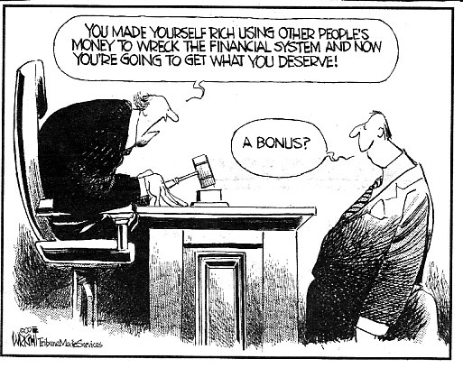

Slide 57
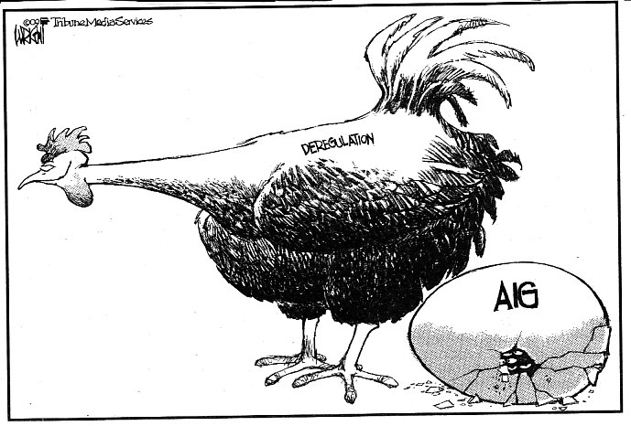

Slide 58
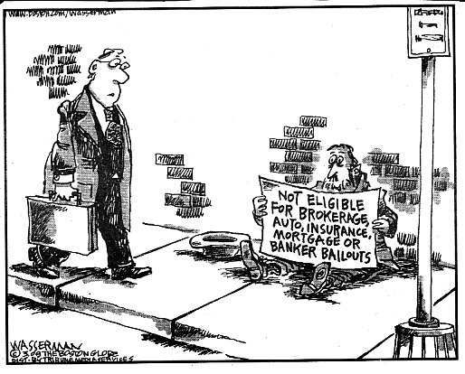

Slide 59
