Slide 1
A Permanent Jobs Program for the US: Taking our Economy Back
Bill Barclay
Chicago DSA and Chicago Political Economy Group

Slide 2
"I see nothing in the present situation that is either menacing or warrants pessimism."
“Liquidate labor, liquidate stocks, liquidate farmers, liquidate real estate…
it will purge the rottenness out of the system. High costs of living and
high living will come down. People will work harder, live a more moral life.
Values will be adjusted, and enterprising people will pick up from less
competent people.“
- Andrew Mellon, Sec of Treasury, 1930

Slide 3
The New Deal Background
July 1932 – Democratic Party met in Chicago to nominate a candidate for president
Had won presidency only 4 times since 1860
45% of Chicagoans unemployed
Over 25% US non-agricultural labor force unemployed
Convention issue: wet or dry?
After many ballots the party nominated a man known as a “trimmer” who avoided taking stands on issues: Franklin Delano Roosevelt
FDR didn’t talk about jobs during his campaign
Attacked Hoover for running deficits
Nov 1932 FDR gets 57% vs Hoover’s 40%

Slide 4
FDR and Jobs
Chicago – and the US – unemployed made an impact on FDR
Challenged cabinet to put 500,000 “young men” to work by summer (remember this is March)
Told by military “a logistic impossibility”
Ok, 250,000
290,000 in CCC by June
FDR was not an economist but he understood two things
An economy can be restarted by creating demand
Out of work people are politically unpredictable
CCC was one of many jobs programs created by FDR
Some put people to work immediately, e.g. CWA, WPA
Others created jobs more slowly, e.g. PWA that used many private contractors

Slide 5
The Impact of New Deal Jobs Programs
Brought unemployment down from over 25% in 1932 to 13 – 14% in 1937
Except for WWII this is the largest decline in unemployment in any similar period in US history
Unemployment jumps in 1938 – why?
FDR tries to return to balancing the budget and
Right wing opposition organizes - Josiah Bailey’s (D-NC) Conservative Manifesto called for reducing spending and cutting taxes, especially on business

Slide 6
“You can Never Step into the Same River Twice” - Heraclitus
The New Deal legacy: the impact of the FDIC
The New Deal (Keynes) legacy:
I guess everyone is a Keynesian in a fox hole – Robt Lucas (2003 AEA address: ‘the central problem of depression prevention has been solved”)
Government intervention stops the free fall
Timing: Obama was elected in 1930 – FDR in 1932
Right wing more organized – and also reads history
However, a deficit is still at the core of our economics and politics – a JOBS deficit

Slide 7
How Big is the Jobs Deficit?
In April 2010 the US economy added 290,000 jobs; in May 431,000 jobs
However, many of the jobs were temporary ones with the census (411,000 of May’s 431,000 & 60,000 of April’s 290,000)
Private sector added 130,000 jobs/month average over past 3 months
12/07 – 3/10 the US lost 8.2 million jobs
In 12/07 there were already 7.3 million unemployed
In addition to the 15.5 million officially unemployed in May, there were
8.8 million working part time/wanted full time and
5.6 million dropped out of labor force but want jobs
Total: 29.4 million

Slide 8
Reducing the Jobs Deficit: How Fast, How Long
At the 130,000/month rate it would take 119 months (almost 10 years) to generate enough jobs just to employ the officially unemployed
However, the labor force grows over 100,000/month so 130,000/month is only 30,000 net new jobs (maximum)
At 30,000 net/month it would take 43 years
The best rate of private sector job creation the US has experienced in the past 40 years was about 500,000/month (immediately after 1973-74 recession)
Using a net of 400,000/month results in 39 months
If we add in the part time/want full time we increase the time to “full” employment by more than 50%
Using most recent period, 2003 – 2007, it will take more than a decade

Slide 9
How Long to Lower Unemployment Rate: 2003 – 2007 Average Job Growth Projected

Slide 10
Who Are the Officially Unemployed?

Slide 11
The Chicago Political Economy Group’s Jobs Program
Figures on the Great Recession are striking
However, CPEG started working on a jobs program prior to the Great Recession
Based on our analysis of the longer term trends in the US political economy
Identified long term job creation problem
Minorities especially but the problem larger
Built the jobs program on 6 principles

Slide 12
www.cpegonline.org

Slide 13
CPEG’s Principles for a Jobs Program
In early 2008 CPEG sat down to work on a jobs program – pre the “Great Recession”
Based on our analysis of U.S. structure and dynamics of U. S. political economy we concluded that any effective jobs program had to be based on 6 principles (each elaborated in next slides)
The private economy had failed to generate sufficient number of jobs to meet the needs of our people
Access to the good jobs has been and is unequally distributed across a working population that is internally segmented by race, ethnicity and gender
The lack of jobs and good jobs is not the result of a lack of work to be done
This double failure of the private economy – macro and micro - necessitates government action to insure more jobs and equality of access to these jobs
Because the private economy’s failure is long term, the role of the government in remedying this failure must also be long term
Governmental policies created to remedy this failure should be redistributive both in their outcomes and in their financing
First 5 are empirically demonstrable or logically deducible – and flowed from our analysis of the US political economy (see following slides)
The 6th is a political and economic judgment

Slide 14
I: Long Term Failure of the Private Economy to Generate Jobs
US Labor force participation rate has been drifting down
Did not recover after 2000 recession
Differ from experience of many other advanced capitalist countries
Post recession job creation is becoming weaker
Employment recovery from recessions is lagging
US post WWII recessions, 1948 – 1980, averaged 9 months to return to pre-recession employment levels with 12 months the maximum
After 1990 recession – 23 months
After 2001 recession – 39 months (a “mild” downturn)
Long term (>26 weeks) share of unemployed has been rising
In 1980 recession’s 10% unemployment rate only 1 in 4 long term
Great Recession: >46% are long term unemployed
US private economy failing to produce jobs at the rate needed, much less good jobs

Slide 15
US Labor Force Participation, 2000 – 2010 (16+ years)

Slide 16
II: Labor Force Segmentation: Unequal Access to Good Jobs
Jobs that are generated are not allocated randomly across the different strata of the U.S. labor force
Evident from income distribution (full time wkrs only)
2009 white male/white female median income ratio: 1.26
2009 white male/black male median income ratio: 1.36
2008 white male/Hispanic male median income ratio: 1.48
2008 black male/black female median income ratio: 1.07
2008 Hispanic male/Hispanic female median income ratio: 1.12
Evident from occupational distribution

Slide 17
Labor Force Segmentation (2009)

Slide 18
III: There Is Useful Work To Be Done
Unemployment is not because of a lack of economically and socially useful work to be done
We need to new upgrade and/or replace much of existing built environment
This includes 24 billion sq ft of building stock in hospitals, healthcare, education and government buildings that could be weatherized (about 20 percent of all US building stock).
We need to replace and renew much of the work done by the CCC and similar programs in our parks and recreational areas
We have a deficit in the provision of care for both the young and the old
US is virtually alone making caring for loved ones a primarily or exclusively private effort

Slide 19
IV & V: The Role of Government
Failure of the private sector to create sufficient jobs and to allocate good jobs across segmented labor force leaves government as the alternative
The primary criterion of judging an economy should be its ability to provide living wage jobs for all who are willing and able to work
Failure is long term – implies government job creation must also be long term
CPEG’s program not temporary, short term or make work jobs
Size and role of US public sector must increase
US public sector small by international standards
This goes along with the greater inequality in income distribution in the US when compared with other advanced capitalist societies

Slide 20
Tax Revenue as % GDP & Gini Index

Slide 21
Public Sector % of GDP and Gini Index
45

Slide 22
VI: Jobs Program as Redistributive Policy
“Never let a serious crisis go to waste”
A jobs program sufficient to respond to the Great Recession should restructure the US political economy
Obvious in extending access to the “good jobs” a program should create: the output side
Of equal importance, a jobs program should be funded by sectors of the political economy that have benefitted from the economic growth and income distribution trends of recent decades: the input (who pay) side
A crisis opens new political and economic opportunities

Slide 23
Sizing CPEG’s Jobs Program
In calculating the number of jobs needed we looked at:
Numbers of un- and under-employed
Rate of growth in labor force
Projections of jobs created by the private sector
These projections developed in 2008 (many use longer time periods)
Potential loss of low wage private sector because of wage level we propose
How many jobs: 4 million/yr over each of the next 5 years
Private sector projected to create 1.5 – 1.6 million jobs/yr (2008 – 2013)
We projected a 1 million/yr job loss in private sector due to wage and working conditions competition from our jobs program
Therefore need to create 3.5 million jobs/year from direct or indirect government action to get to our 4 million/yr job creation target

Slide 24
What Jobs Should be Created?
Three criteria to consider
Labor force segmentation: need to reach all segments
What should an economic growth policy emphasize?
Where are jobs being lost in Great Recession?
Jobs should be created across three different sectors
Traditional infrastructure: roads, bridges, also schools and health facilities
Much of this would be publicly funded but contracted to private sector
Construction accounts for almost 25% of total job loss, 12/07 – 4/10
Jobs to meet the social service deficit
Teachers & teachers aides
Nurses & CNAs
Elder and child care workers
Most of these jobs would be direct government employment, i.e., an expansion of the public sector
In a segmented labor force this area of job creation would initially draw in disproportionately women and minorities
Forward looking Industrial policy focus
Jobs in green technologies of the future, e.g., light rail, alternative energy production and distribution
Probably a combination of contracting and direct employment altho the latter may be essential to get this up and running

Slide 25
A Digression: Industrial Policy
US political and economic elites generally dismiss the idea of an industrial policy
Markets know best how to pick winners
Markets are best able to shift gears, to recognize early the new leading industries
Of course, this ignores the experience of several countries – Japan, China, Scandinavia
It is also misleading – we have had an industrial policy for the past 20 -35 years: the development and expansion of finance and financial services
Manufacturing left to down size and outsource
How has this worked?
Pretty well for finance and financial employees: profits of financial firms rose from their long term share of 20 – 22% to almost 45% in 2005
Financial employment became increasingly rewarding – average wage almost double that of the economy as a whole vs. a long standing premium of perhaps 20%
And, of course, we were able to export part of our economic crisis to the rest of the world
Nonetheless, I think we can agree that the overall balance sheet of this industrial policy has been negative
Current “Great Recession” is not the first crisis that was created by the financial sector: LTCM, S&Ls, Asian Tigers, etc.

Slide 26
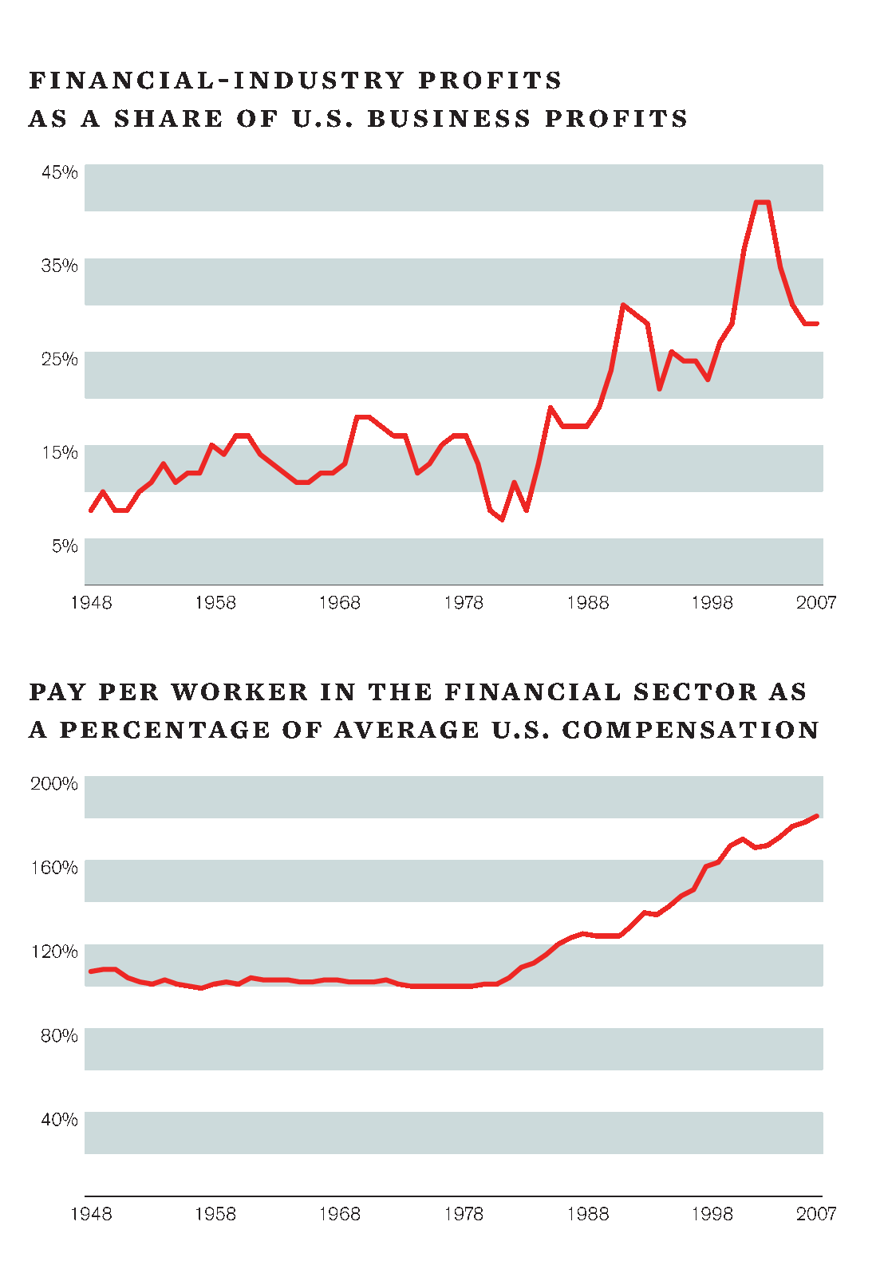
Dr. Wm Barclay - The Financial/Economic Crisis
26

Slide 27
What Kind of Jobs Should be Created - Good Jobs
What do we mean by Good Jobs?
Wage and salary level is probably the first criterion that comes to mind – living wage jobs
We designed the program – and the cost calculations I’ll show soon – at the median salary level in 4Q09: $18.47/hr or $38,400/yr
However, the program is designed not just to generate jobs for those who have become unemployed – draw into the labor many of the long term unemployed/never employed
Therefore “training ramps” with an initial wage at $11.15/hr (breaking point between poverty and non-poverty wage)

Slide 28
What else do Good Jobs Offer?
Good jobs are also those that :
Provide some level of security against unexpected catastrophes and
Some say in how the work is organized
All jobs under this program shall have access to the health policy reforms that made it out of Congress (whatever we may think of them)
All workers employed under this jobs program shall have the right to associate together to articulate their needs in whatever organizational form they choose – (probably unions)
Because this program is long term, these jobs must also establish possible career ladders
Long term, not temporary jobs

Slide 29
The Cost of the Program
There are three cost components that need to be considered
Wage levels
$18.50/hr + training wage of $11.75/hr
$117.5 billion in year 1 up to $127 billion by year 5
Overhead/administrative costs
5% overhead costs (higher than Social Security)
Wages above $18.50 for supervisory labor
Added 30% premium – less than private sector but goal is redistributive
Total annual cost varies from $158.6 billion in yr 1 up to $171.5/cohort in yr 5 or $860 billion total
Remember the public funding is ongoing
$860 billion is approximately 6% of 2009 US GDP
Offsets we did not include: UI, taxes paid, etc
Each 1% decline in unemployment cuts federal spending/increases federal tax receipts by about $90 billion

Slide 30
Reporter: Why do you rob banks?
Willie (“The Actor”) Sutton: Because
that’s where the money is.

Slide 31
Paying for the Program
In August 2008 we came up with the $860 billion number and looked at each other – wow! That’s a lot of money
Two months later we discovered that it really isn’t a lot of money
Nonetheless, we set out to decide how to pay for the program – keeping in mind our 6th principle: redistribution

Slide 32
Can We Afford the Economic Right of a Living Wage Job for All?
Many pundits as well as political and economic leaders are anxious to convince us that the fiscal cupboard is bare – we can’t afford significant “domestic” social or economic programs
In fact, there is a growing chorus that says we must reduce our expectations, we must cut back
We could, of course, seek to finance our Right to a Living Wage Job by deficits
Moody’s has recently said that the US should “watch out” because our federal budget deficit may cause markets to refuse to buy US govt. debt – and of course they were so on target with their ratings on securitized mortgages
We (CPEG) don’t believe the deficit scare stories
However, we do believe in the Willie Sutton philosophy – go “where the money is”
This approach is integral to our 6th point, that, just as a Living Wage Jobs for All Right must redistribute access to good jobs, so must the financing of the program be redistributive in its impact
So, how can we pay for it – let’s be “responsible” policy wonks

Slide 33
“When the capital development of a country becomes a byproduct of the activities of a casino, the job is likely to be ill-done.‘‘ - Keynes
So, where is the money – finance and the financial sector
The rise of finance illustrated by the share of total profits accruing to financial sector as well as the increased salary level in finance
Another measure of the shift in our political economy: in 2007 US consumers spent less on new automobiles than on investment counseling and brokerage services – in 1979 we spent ten times as much on the former as on the latter
Keynes once urged a tax on the trading of stock to reduce the attraction of the casino
In 1973 James Tobin (Nobel Prize economist) argued for a tax on currency the trading
Argued that the rapid, large movements in the markets for currency are destabilizing and do not represent actual economic changes
In 1989, two economists, following Keynes and Tobin, wrote a paper advocating a small tax on the trading of financial assets, i.e., stocks, bonds, currencies and derivatives thereon
Larry and Victoria Summers were following in the footsteps of Keynes (tax stock trading) and James Tobin (tax currency trading)
Very good job in anticipating and responding to possible criticisms
Stiglitz, Krugman and others have urged such a tax
HR 4191 and S 2927 embody weak versions of the tax;
The Robin Hood Tax people in the UK are urging a more robust version

Slide 34
Where the Money Is
At the time the Summers wrote, total stock trading value in the US was about $2 trillion
A lot of in money? Well, in 2008 the total stock traded value in the US was almost $70 trillion – what else has increased 35 fold in 20 years?
Total US equity market cap has increased only 4 fold (6 fold if we take 2007)
In 2008 equity-based derivatives trading represented another $86 trillion in notional (underlying) value of trading
In addition there is trading in debt and debt derivatives as well as currency and currency derivatives
These markets as large or larger in size to those for stocks and stock derivatives
Lord Turner (UK’s senior financial regulator): much of this trading is “socially useless”
A tax on the trading of financial assets (FTT) would tap this “socially useless” activity

Slide 35
An FTT: How Would it Work and How Much revenue could it Raise?
Issues to consider
Financial assets traded in different markets, e.g. on and off exchange
Financial assets trade in different forms, e.g. futures and options
No market or instrument should be advantaged/disadvantaged by an FTT
We used fairly standard levies
$1 fee (tax) on every $400 of stock traded (0.25%/side)
$1 fee (tax) on every $800 of currency, debt, and all derivative notional value traded (0.1%/side) (see Dissent Summer 2010 article – out soon; or go to www.CPEGonline.org) for more details
Applying these rates to the 2005 – 2009 period, an FTT would have raised between $750 billion - $1.3 trillion each year
We just paid for the Economic Right of a Living Wage Job for All

Slide 36
What Impact might a Comprehensive FTT have?
What impact – would an FTT undermine US competitiveness?
One answer may be “so what” – finance and financial trading got us into this mess so the less of it, the better
I have some sympathy with this position but not completely (maybe 22 years in finance biases me?)
However, if this very small tax did the following, I think it would be a good outcome
Reduced the role of finance by reducing the level of trading – very, very little of the trading that occurs has anything to do with either capital raising or hedging
Reduce the incomes accruing to employees in the financial sector and thus provide less incentive for the best of our young people to enter finance and instead consider other careers – this happened in the 1930s -1940s
Some clever finance people may chose to leave the US and work elsewhere – although elsewhere is getting harder for financial engineers/quants to find – anyway, don’t let the door hit you on the ass on the way out

Slide 37
Who Would Pay an FTT?
Obviously people/institutions who trade – who are these?
Day traders: what social benefit arises from trading for less than 0.25% profit?
Hedge funds and proprietary trading desks of investment banks
The 10 – 15% of the upper income US population that own most of the stocks held by individuals
Median size of stock holdings exceeds $20,000 only among the top 10% of households by income
Anyone who has a 401(k) – choose low trading funds – you’ll be better off anyway

Slide 38
Other Sources of Financing
A 5% Income tax surcharge on all households receiving >$250,000/yr: minimum of $200 – 250 billion
If the top 400 income receivers in 2007/8 paid taxes at the “socialist” Eisenhower rate, we would have garnered an additional $100 billion
A reinstatement of the Estate Tax (“Paris Hilton Tax”) at pre-Bush levels and making it progressive: $100 – 150 billion
An excess profits on energy companies: $50 billion (part of carbon tax)

Slide 39
Tax Revenue as % GDP & Gini Index – CPEG Jobs Program fully in place and Funded*
*Assumes no GDP change from 2009

Slide 40
Comparing Job Creation Programs
Others have also developed jobs programs
CPEG is (almost) unique in focusing on:
Size of the problem
Long term nature of the program – expanding the public sector
Increasing lag time to return to pre-recession employment levels
Increasing problem of long term unemployment
Redistributive financing of the program
Three other proposals:
George Miller’s “Local Jobs for America Act”
$100 billion over 2 years to create 1 million jobs
State and local govt. + non-profit sector
EPI’s “American Jobs Plan”
4.5 million jobs in first year
$400 billion cost
Phased in FTT to pay for program over 10 years
Robert Pollin’s proposal in recent Nation article
18 million jobs in 3 years
Funded primarily by use of banks’ $850 billion in reserves
Uses federal government guarantees for new loans + Fed pressure to drive down interest rates for borrowers

Slide 41
Approaches to Designing Jobs Programs
Jobs policies in capitalist economies appear in two basic variations
Job Security Model:
Attempt to increase the ability of an employee to retain their existing job by limiting the ability/increasing the cost to private capital of layoffs (“job security” – Continental Model; also US?)
Labor Force Security Model
Attempt to provide job security for the working population as a whole by insuring an adequate supply of jobs, potentially replacing private capital as the primary source of jobs (labor force security” – Nordic Model)
CPEG’s approach is the latter – allows for a high degree of labor mobility coupled with income security by creating living wage jobs
Goal: living wage jobs for all willing and able to work as a basic economic right:
Harks back to FDR’s call for a second bill of rights: “The right to a useful and remunerative job in the industries or shops or farms or mines of the nation”
This is the first right in DSA’s “A Social and Economic Bill of Rights for the 21st Century”

Slide 42
GDP per capita Growth Rates

