Slide 1
A LaSalle Street Tax: Financing Human Needs in Illinois
Dr. William Barclay
Chicago Political Economy Group
Adjunct Professor, Liautaud Graduate School of Business

Slide 2
What is the LaSalle Street Tax?
The LaSalle Street Tax is proposed by Illinois state representatives and senators.
There would be a very small tax on the trading of futures and option contracts.
The average size (notional value) of these contracts is more than $225,000.
The LaSalle Street Tax could be (draft legislation):
$1 fee all agricultural contracts
$2 fee on all non-agricultural contracts
This rate is less than 1/100th of the IL state sales tax rate.

Slide 3
Why is Illinois a good place for a LST?
Chicago has two very large markets where futures and options and traded.
Chicago Mercantile Exchange (CME)
Chicago Board Options Exchange (CBOE)
CME:
Owns Chicago Board of Trade
Trades futures and futures options on stock indexes, interest rates, currencies and commodities
Largest futures exchange in the world
CBOE:
Trades securities options on stock indexes (and individual stocks)
Largest options exchange in the world

Slide 4
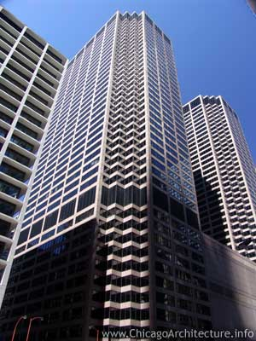
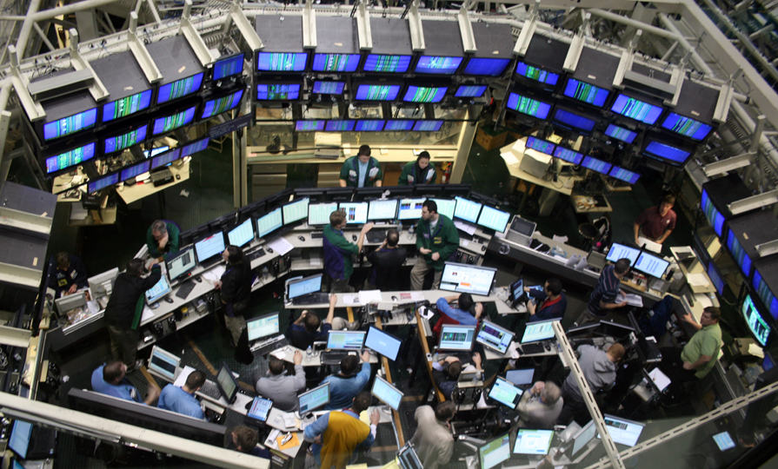

Slide 5
How could the LaSalle Street Tax raise much money?
The proposed tax rate is very low, but:
The amount of trading is very big: 10 – 15 million contracts every day.
Thus the amount raised would be significant: $10–12 billion a year at current volume levels with the $1 and $2 fee.
The tax would be paid by both buyers and sellers of futures and option contracts.
The Illinois state budget is $35-$40 billion.
Thus the LaSalle Street Tax would raise a large amount of money to meet needs of our people.
Illinois gross state product is $750 billion; LST is about 1.6% of Illinois GSP.

Slide 6
A very small tax can raise a lot of money.
$9.6
$12.6
$11.7

Slide 7
What would be the impact on the exchanges? Would they move?
The LaSalle Street Tax would not be paid by the exchanges.
Thus there would be no direct economic incentive for the exchanges to move.
It would be paid by people and institutions that trade.
These include hedge funds, banks, high frequency traders and other speculators.
The futures and options traded on the CME and CBOE that would be taxed are not traded anywhere else.
Some high frequency trading would not longer be profitable.
However, retirement accounts, e.g. ,401(k) could be exempted from the tax.

Slide 8
Would traders go elsewhere?
A real life experiment: In 2012 the ELX (Electronic Liquidity Exchange) opened.
ELX charged $1.25–2.00 less to trade several of the same contracts as the CME.
The fee reduction is similar in amount to the proposed LaSalle St Tax
ELX had the backing of JP Morgan Chase, Morgan Stanley, and Goldman Sachs.
What happened?
ELX’s best volume was achieved when their monthly trades in some contracts almost equaled the daily trades in the same contracts on the CME.
There was no impact on CME volume.
Liquidity is very hard to move.

Slide 9
Would the exchanges move?
It is not just “putting a server on a truck” and going to Indiana.
CME: 428,000 sq. ft. data facility in Aurora for trade execution and matching (7 football fields)
CME firms have a large investment in “co-location”
Firms place their order sending/execution servers as close as possible to CME matching engines to achieve “low latency.”

Slide 10
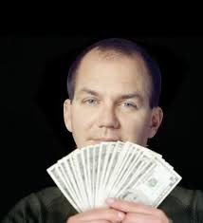
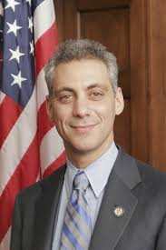
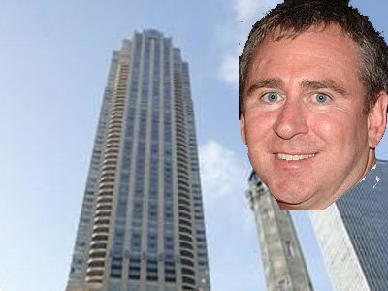
Of course, some people and companies will resist the LST.
.
High frequency trading firm
profitable on 1,277 of 1,278
trading days over past 5 years.
Trades over 10,000 “products.”
Proposing an IPO.
Terry Duffy, CEO and
president, CME Group
Paul Tudor Jones,
trading billionaire
Terrence A. Duffy, CME Group
Executive Chairman and President
Ken Griffen, HFT and CME

Slide 11
The Proposed LST and Tax Policy
What is good tax policy?
A good tax should be a small amount for any single event.
A good tax should raise significant amount of revenue.
A good tax should be low cost to collect.
A good tax should fall on those able to bear the tax.
A good tax should tax activity that we want to limit or discourage.
Lord Adair Turner, former senior UK financial regulator: Much of what goes on in finance is “socially useless” activity.
A good tax should also further economic or social justice.

Slide 12
The Social Justice Argument for a LaSalle Street Tax: What could the revenue do?
Reverse decades of underfunding and understaffing of human services and human needs.
Boost funding for public education. (Today Illinois ranks last in state share of funding for education.)
Use revenue to make up for the decades-long failure of the Illinois legislature to keep their pension funding promises.
Fund thousands of jobs preserving the environment, improving energy efficiency, rebuilding public infrastructure, etc.

Slide 13
Sources for additional information:
http://lasallestreettax.org/
Includes a link to a recent Chicago Reader article by Ben Joravsky
http://www.allianceforcommunityservices.org/ Alliance for Community Services
http://www.cpegonline.org/
Chicago Political Economy Group website has an article by Bill Barclay on the LST.

